Slide 1
Multi-Dimensional
Well-Being, Deprivation, and Inequality
Peter Krause
21st German STATA Conference
GESIS Mannheim | June 7 2024
Dr Peter Krause - German Institute for Economic Research (em.)
DIW Berlin / SOEP, Berlin, Germany
pkrause@diw.de

Slide 2
Outline
[1] Framing – Multidimensional Measures for WellBeing Applications
[2] MPI | MWI – Deprivation & Well-Being | AF (IR) | Fixed-Fuzzy-Aproach
[3] M|K|GG – Inequality (vertikal|horizontal) | Gini | Subgroup-Indices
[4] Programs – MPI | MWI | MGDIV || DimWeight | Rescale
[5] Outlook | Discussion

Slide 3
Framing
[1] Framing – Why Multi-dimensional WellBeing Applications?
1.1 Identifying individual overlaps in well-being indicators {across conception levels}
1.2 Identifying shifts in multiple deprivations | well-beings | inequalities {for opinion dynamics}
1.3 Providing structured (output) indicators for statistical (regression) analyses {individual scores}

Slide 4
Programs
mppis // multi-dimensional Deprivation and Poverty
mwwis // multi-dimensional WellBeing and Wealth
mgdiv // multi-dimensional Inequality | Gini
Tools
dimwgt // multi-dimensional weighting
rescale // multi-dimensional rescale
All programs provide -new- features to adress issues of deprivation, wealth and inequalities not only as tensions between rich and poor - but also as variations of wellbeing for the entire majority of population with more ordinary living standards.

Slide 5
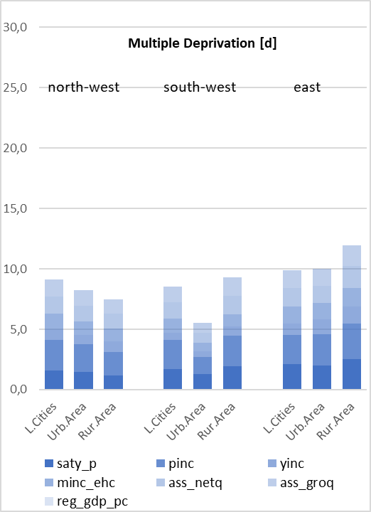
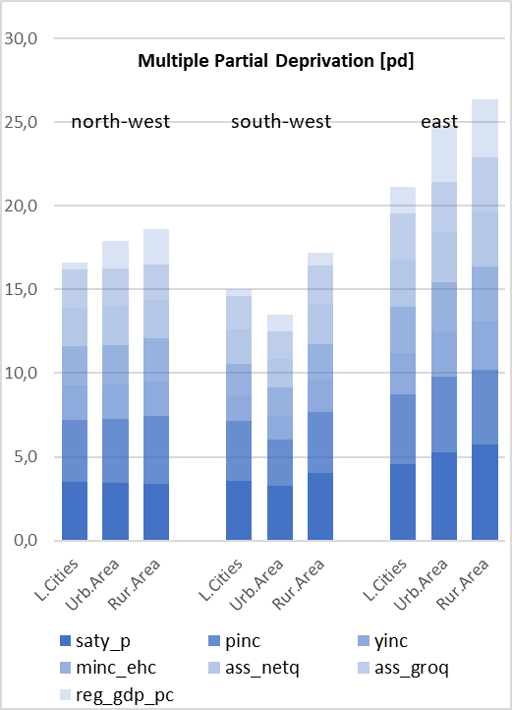
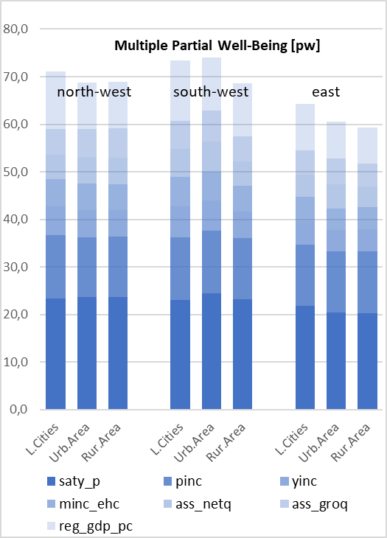
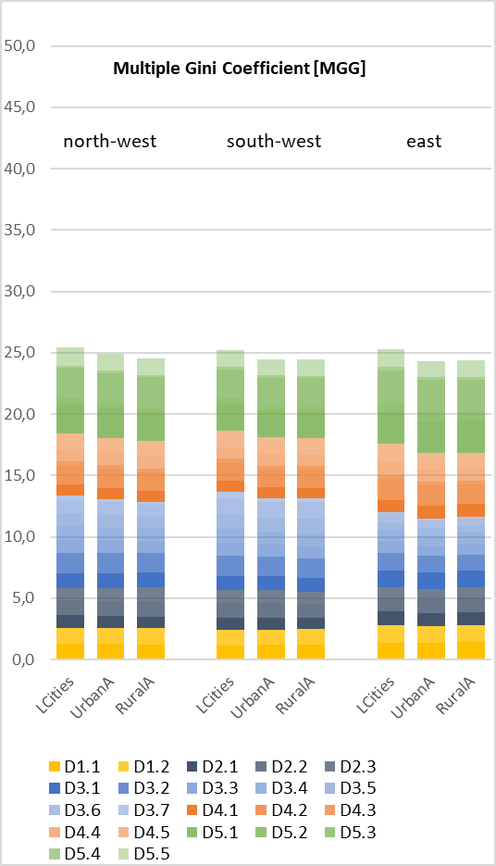
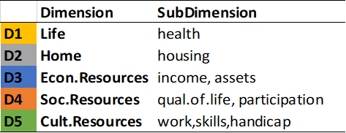
M-Dim – Deprivation & Well-Being [standard and fixed-fuzzy approach, AF] | Inequalities [M-Gini]
mppis [d]
(dimwgt)
mppis [pd] (dimwgt)
mwwis [pd] (dimwgt)
mgdiv rescale (dimwgt)
SOEPv37 [2017; total population | adults 20+]
Krause (2024) [forthcoming]

Slide 6
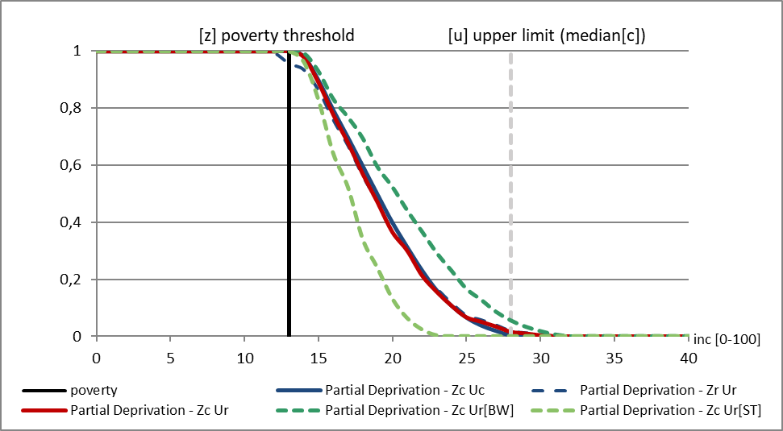
Degrees of (partial) deprivation in national and regional settings (Germany, 2018)
mppis [pd] – one-dimensional
z_{c} national pov-line [country]
z_{r} regional pov-line [region]
u_{c} national upper-line [country]
u_{r} regional upper-line [region]
Baden-Wuerttemberg [BW] and Saxony-Anhalt [ST] [SOEPv35, 2018: Med-C: 22.431 EUR; Med-BW: 24.982 EUR; Med-ST: 18.318 EUR].
Results refer to the entire national population [C].

Slide 7
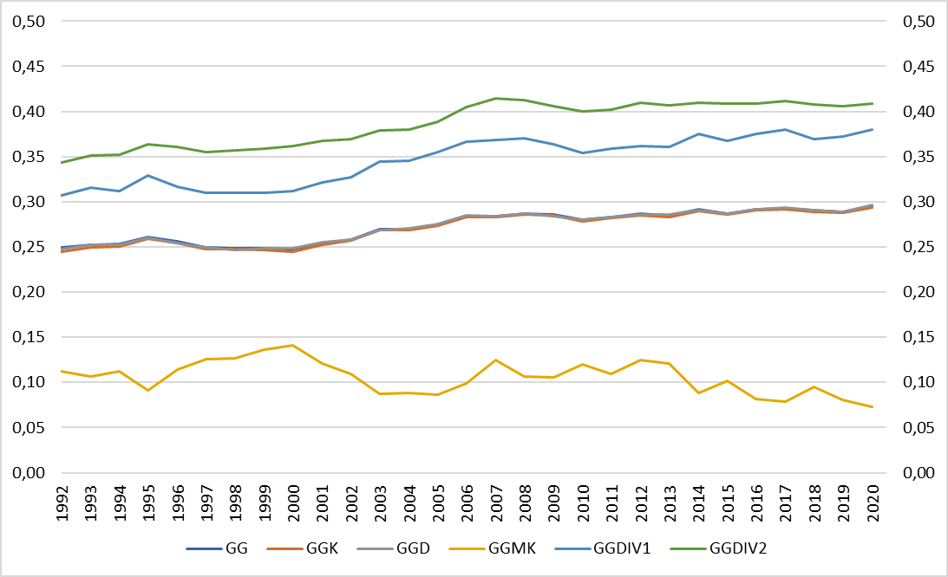
Inequality and Diversity
HH-Net-Eq.Incomes
mgdiv – one-dimensional

Slide 8
One- and multi-dimensional between-group inequalities in regional settings
mgdiv – m|k-dimensional

Slide 9
MPI | MWI
[2] Multidimensional Poverty Index [MPI] | Multidimensional WellBeing Index [MWI]
2.1 Fixed-Fuzzy-Approach – conception | absolute-relative | (integration, segmentation)
2.2 Identification - AF (dual-cutoff) {censored deprivation account} | also applied to WellBeing
2.3 Aggregation – (M0,M{α}) | FGT-Modification | non-linear cardinal assignments)

Slide 10
Fuzzy Zones of Precarity
Fuzzy Zones of Prosperity
Fixed-Fuzzy-Approach
Degrees (Partial) Deprivation
select indicator(s) [dimension]
define fuzzy zones of prosperity [w, l]
extract degrees of wealth
run counting approach
Degrees (Partial) Wealth
select indicator(s) [dimension]
define fuzzy zones of precarity [z, u]
extract degrees of deprivation
run counting approach
[Krause (2019; 2024) forthcoming]

Slide 11
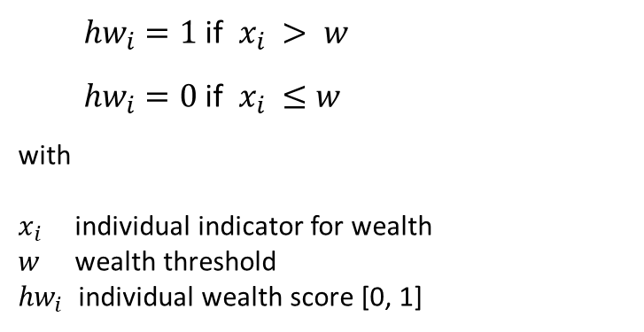
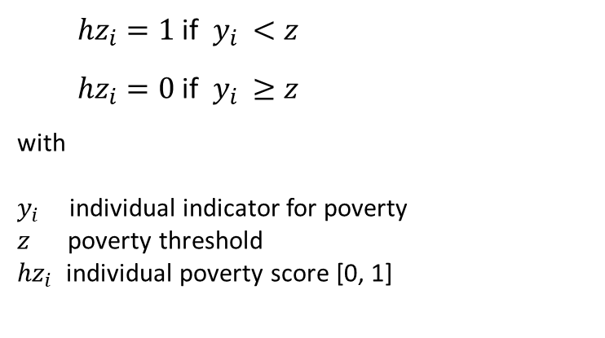
Identification of Deprivation [Poverty]
-- lack of capabilities --
Identification of Well-Being [Wealth]
-- capabilities --
${hz}_{i}=1$ if $y_{i }<z$
${hz}_{i}=0$ if $y_{i }≥z$
with
$y_{i }$ individual indicator for poverty
$z$ poverty threshold
${hz}_{i}$ individual poverty score [0, 1]
${hw}_{i}=1$ if $x_{i }> w$
${hw}_{i}=0$ if $x_{i }≤w$
with
$x_{i }$ individual indicator for wealth
$w$ wealth threshold
${hw}_{i}$ individual wealth score [0, 1]
Aggregation of Deprivation [Poverty]
Aggregation of Well-Being [Wealth]
FGT0, 1, … {α} [adjusted FGT]
M0, 1, … {α} [AF, dual-cutoff, .33]
FGT0, 1, … {α} [adjusted FGT]
W0, 1, … {α} [AF, dual-cutoff, .33]
Foster/Greer/Thorbecke 1984, 2010;
Alkire/Foster 2011a,b; Alkire et al. 2015
Peichl/Pestel 2013; Krause 2019;

Slide 12
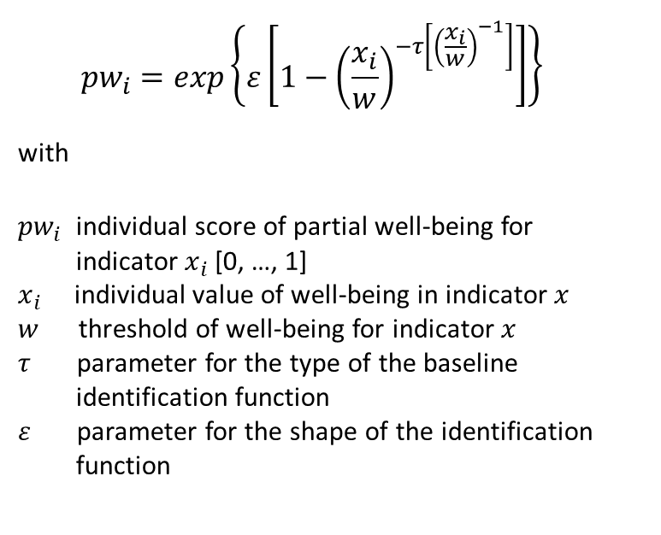
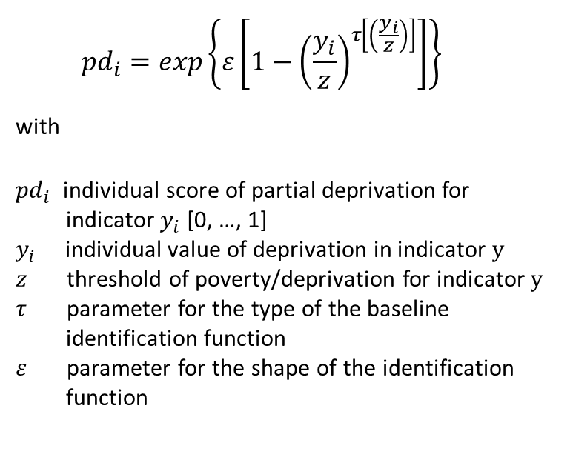
Identification of Partial Deprivation
Identification of Partial Well-Being
Fixed-Fuzzy-Approach
$${pd}_{i}=exp\left\{ε\left[1−{\left(\frac{y_{i}}{z}\right)}^{τ\left[\left(\frac{y_{i}}{z}\right)\right]}\right]\right\}$$
with
${pd}_{i}$ individual score of partial deprivation for
indicator $y_{i}$ [0, …, 1]
$y_{i}$ individual value of deprivation in indicator $y$
$z$ threshold of poverty/deprivation for indicator $y$
$τ$ parameter for the type of the baseline
identification function
$ε$ parameter for the shape of the identification
function
$${pw}_{i}=exp\left\{ε\left[1−{\left(\frac{x_{i}}{w}\right)}^{−τ\left[{\left(\frac{x_{i}}{w}\right)}^{−1}\right]}\right]\right\}$$
with
${pw}_{i}$ individual score of partial well-being for
indicator $x_{i}$ [0, …, 1]
$x_{i}$ individual value of well-being in indicator $x$
$w$ threshold of well-being for indicator $x$
$τ$ parameter for the type of the baseline
identification function
$ε$ parameter for the shape of the identification
function
Aggregation of Partial Deprivation
Aggregation of Partial Well-Being
FGT0, 1, … {α} [adjusted FGT]
M0, 1, … {α} [AF, dual-cutoff, .33]
FGT0, 1, … {α} [adjusted FGT]
W0, 1, … {α} [AF, dual-cutoff, .33]
Krause 2019; 2024/forthcoming

Slide 13
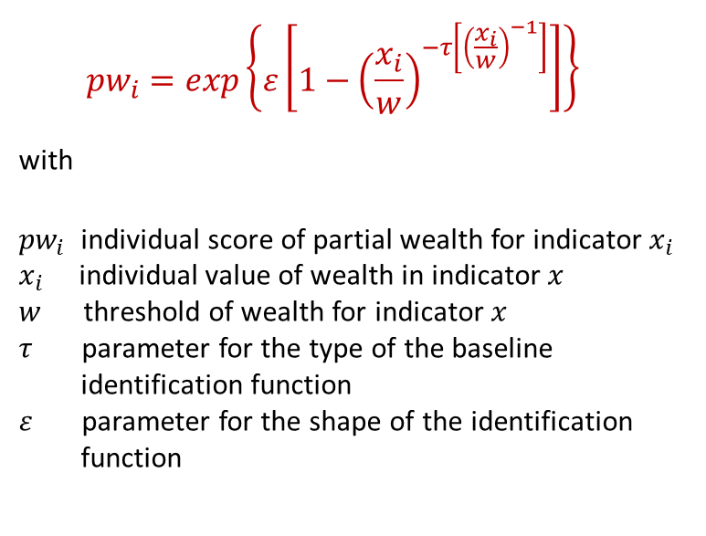
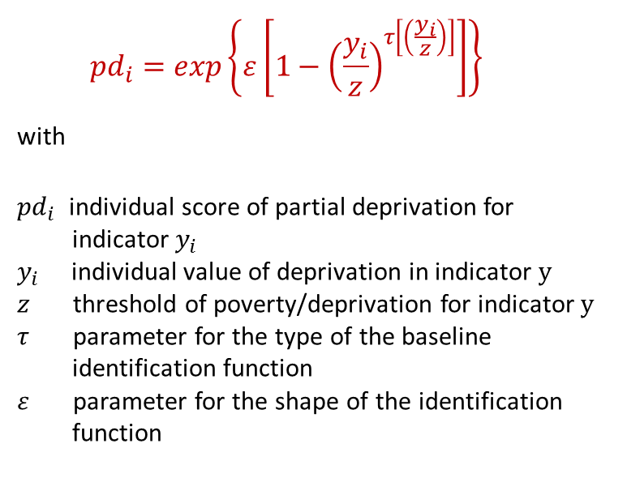
[2] Identification of Partial Deprivation
[2] Identification of Partial Wealth
$${pd}_{i}=exp\left\{ε\left[1−{\left(\frac{y_{i}}{z}\right)}^{τ\left[\left(\frac{y_{i}}{z}\right)\right]}\right]\right\}$$
with
${pd}_{i}$ individual score of partial deprivation for
indicator $y_{i}$
$y_{i}$ individual value of deprivation in indicator $y$
$z$ threshold of poverty/deprivation for indicator $y$
$τ$ parameter for the type of the baseline
identification function
$ε$ parameter for the shape of the identification
function
$${pw}_{i}=exp\left\{ε\left[1−{\left(\frac{x_{i}}{w}\right)}^{−τ\left[{\left(\frac{x_{i}}{w}\right)}^{−1}\right]}\right]\right\}$$
with
${pw}_{i}$ individual score of partial wealth for indicator $x_{i}$
$x_{i}$ individual value of wealth in indicator $x$
$w$ threshold of wealth for indicator $x$
$τ$ parameter for the type of the baseline
identification function
$ε$ parameter for the shape of the identification
function

Slide 14
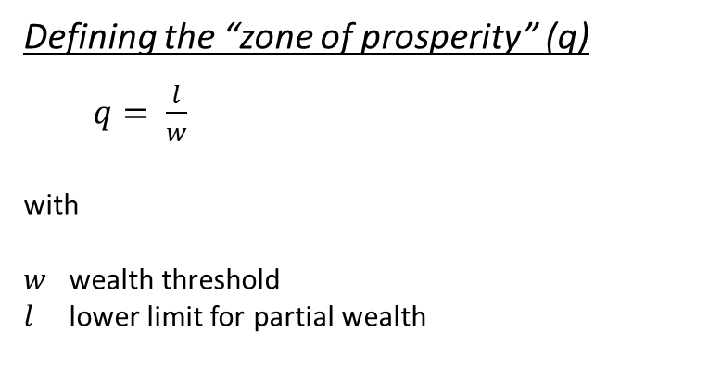
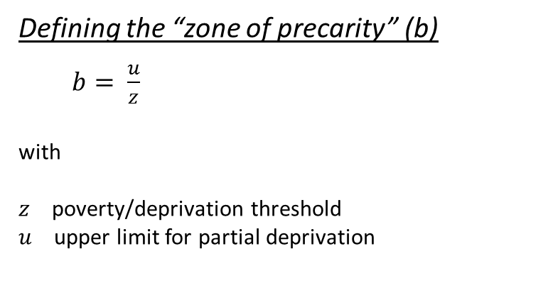
[2] Identification of Partial Deprivation
[2] Identification of Partial Wealth
Defining the “zone of precarity” (b)
  $b= \frac{u}{z}$
with
$z$ poverty/deprivation threshold
$u$ upper limit for partial deprivation
Defining the “zone of prosperity” (q)
  $q= \frac{l}{w}$
with
$w$ wealth threshold
$l$ lower limit for partial wealth

Slide 15
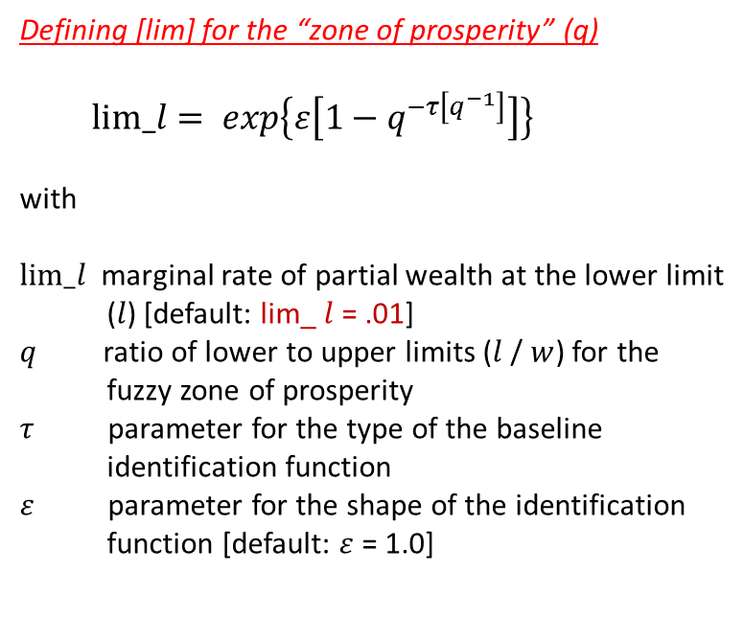
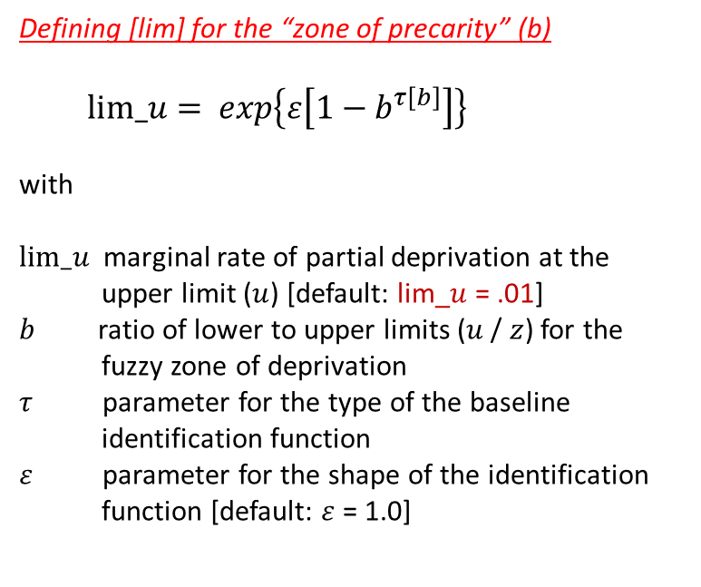
[2] Identification of Partial Deprivation
[2] Identification of Partial Wealth
Defining [lim] for the “zone of precarity” (b)
  $$lim_u= exp\left\{ε\left[1−b^{τ\left[b\right]}\right]\right\}$$
with
$lim_u$ marginal rate of partial deprivation at the
upper limit ($u$) [default: lim_$u$ = .01]
$b$ ratio of lower to upper limits ($u$/ $z$) for the
fuzzy zone of deprivation
$τ$ parameter for the type of the baseline
identification function
$ε$ parameter for the shape of the identification
function [default: $ε$ = 1.0]
Defining [lim] for the “zone of prosperity” (q)
  $$lim_l= exp\left\{ε\left[1−q^{−τ\left[q^{−1}\right]}\right]\right\}$$
with
$lim_l$ marginal rate of partial wealth at the lower limit
($l$) [default: lim_ $l$ = .01]
$q$ ratio of lower to upper limits ($l$/ $w$) for the
fuzzy zone of prosperity
$τ$ parameter for the type of the baseline
identification function
$ε$ parameter for the shape of the identification
function [default: $ε$ = 1.0]

Slide 16
Different lim_u* → Segmentation Approach
* at ε=1 and τ=1,2434

Slide 17
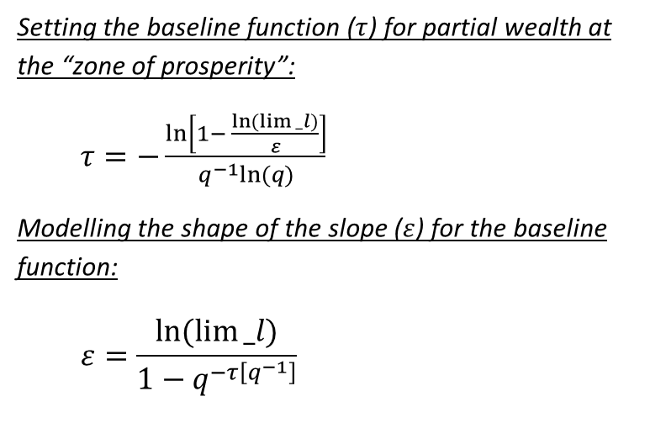
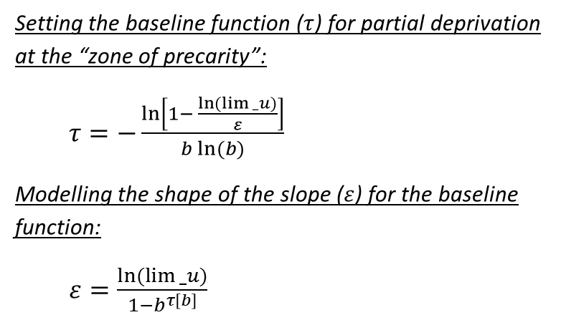
[2] Identification of Partial Deprivation
[2] Identification of Partial Wealth
Setting the baseline function ($τ$) for partial deprivation at the “zone of precarity”:
  $τ=−\frac{ln⁡\left[1− \frac{ln(lim{_u)}}{ε}\right]}{b ln⁡(b)}$
Modelling the shape of the slope ($ε$) for the baseline function:
  $ε=\frac{ln(lim{_u)}}{{1−b}^{τ\left[b\right]}}$
Setting the baseline function ($τ$) for partial wealth at the “zone of prosperity”:
  $τ=−\frac{ln⁡\left[1− \frac{ln(lim{_l)}}{ε}\right]}{q^{−1}ln⁡(q)}$
Modelling the shape of the slope ($ε$) for the baseline function:
  $$ε=\frac{ln(lim{_l)}}{{1−q}^{−τ\left[q^{−1}\right]}}$$

Slide 18
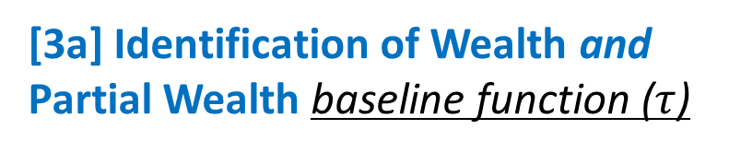
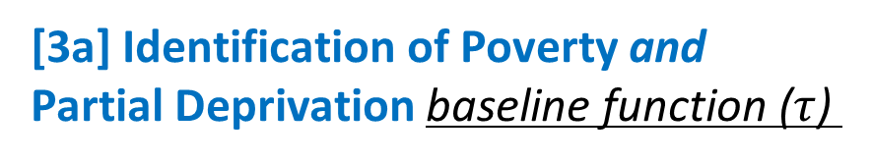
[3a] Identification of Poverty and
Partial Deprivation baseline function ($τ$)
[3a] Identification of Wealth and Partial Wealth baseline function ($τ$)

Slide 19
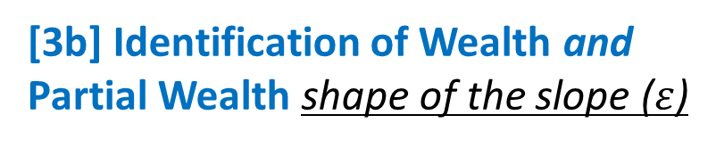
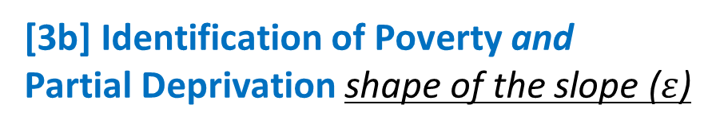
[3b] Identification of Poverty and
Partial Deprivation shape of the slope ($ε$)
[3b] Identification of Wealth and Partial Wealth shape of the slope ($ε$)

Slide 20
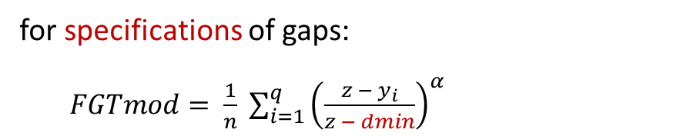
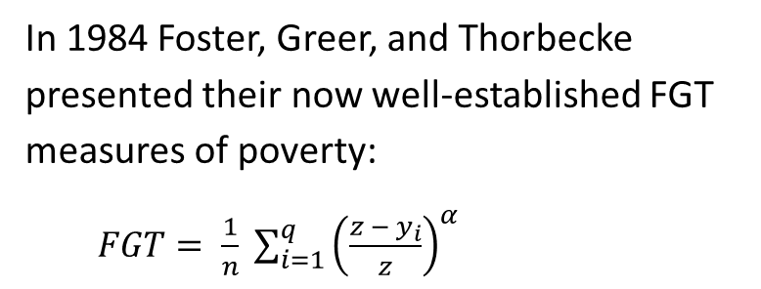
[4] FGT-Measurement of Poverty
In 1984 Foster, Greer, and Thorbecke presented their now well-established FGT measures of poverty:
$FGT= \frac{1}{n} \sum_{i=1}^{q}{{\left(\frac{z − y_{i}}{z}\right)}^{α}}$
[4a] Modified FGT-Measurement of Poverty
for specifications of gaps:
$FGTmod= \frac{1}{n} \sum_{i=1}^{q}{{\left(\frac{z − y_{i}}{z − dmin}\right)}^{α}}$

Slide 21
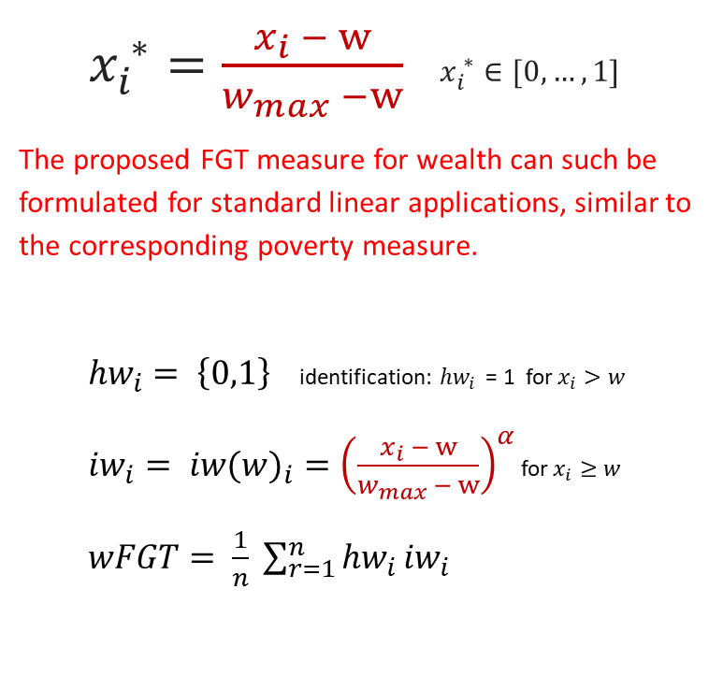
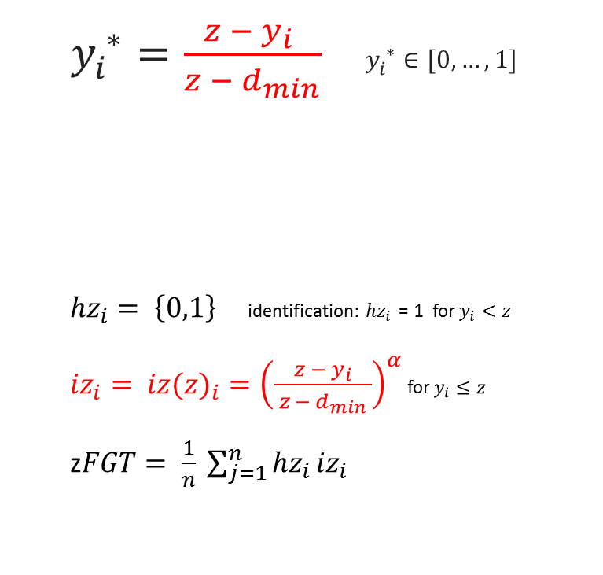
[6] Adjusted FGT Aggregation of Poverty
[6] Adjusted FGT Aggregation of Wealth
  $y_{i}^{ ∗}=\frac{z − y_{i} }{{z − d}_{min}}$ $y_{i}^{ ∗}∈[0,…,1]$
${hz}_{i}= \left\{0,1\right\}$ identification: ${hz}_{i}$ = 1 for $y_{i}<z$
${iz}_{i}= {iz(z)}_{i}={\left(\frac{z −{ y}_{i}}{{ z − d}_{min} }\right)}^{α}$ for $y_{i}≤z$
z$FGT= \frac{1}{n} \sum_{j=1}^{n}{{hz}_{i }{iz}_{i }}$
  $x_{i}^{ ∗}=\frac{x_{i} − w}{w_{max} −w}$ $x_{i}^{ ∗}∈[0,…,1]$
The proposed FGT measure for wealth can such be formulated for standard linear applications, similar to the corresponding poverty measure.
${hw}_{i}= \left\{0,1\right\}$ identification: ${hw}_{i}$ = 1 for $x_{i}>w$
${iw}_{i}= {iw(w)}_{i}={\left(\frac{x_{i} − w}{w_{max} − w}\right)}^{α}$ for $x_{i}≥w$
$wFGT= \frac{1}{n} \sum_{r=1}^{n}{{hw}_{i }{iw}_{i }}$

Slide 22

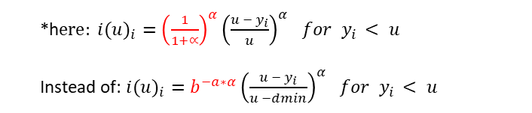
[12] Joint Cardinal FGT Measures
for Intensity (gaps) of
Poverty and Partial Deprivation*
[12] Joint Cardinal FGT Measures for Intensity (negative gaps) of Wealth and Partial Wealth
*h$ere: {i(u)}_{i}={\left(\frac{1}{1+∝}\right)}^{α}{\left(\frac{u − y_{i}}{u}\right)}^{α}$ $for y_{i }< u$
Instead of: ${i(u)}_{i}=b^{−a∗α}{\left(\frac{u − y_{i}}{u −dmin}\right)}^{α}$ $for y_{i }< u$
${{i(l)}_{i}=q^{a∗α}\left(\frac{x_{i} − l}{d_{max} − l}\right)}^{α}$ $for x_{i }>$ l

Slide 23
Distribution of conventional income poverty rates (60%med) and related partial deprivation rates in Germany, 2009-2013
SOEPv31l (2010-2013); z=60%med. pd: τ=2.0246, b=5/3, u=med, lim_u=0.01.

Slide 24
… Rich versus Poor …
… Rich and Poor …
Partial Approach – Concepts for Rich and Poor may overlap
Standard Approach – Concepts for Rich and Poor are exclusive

Slide 25
M | K | GG GINI Indices
[3] Multidimensional | K-dimensional GINI Inequality Indices [M|K|G.. , M|K|GG..]
3.1 Gini Index – calculation | within-between-group notification | population adjustments
3.2 M|K-dimensional Gini SubIndices - (decomposition by k-group | subgroup | dimension)
3.3 Horizontal Inequalities – (Diversities) | inequality notions)

Slide 26
GINI Indices

Slide 27
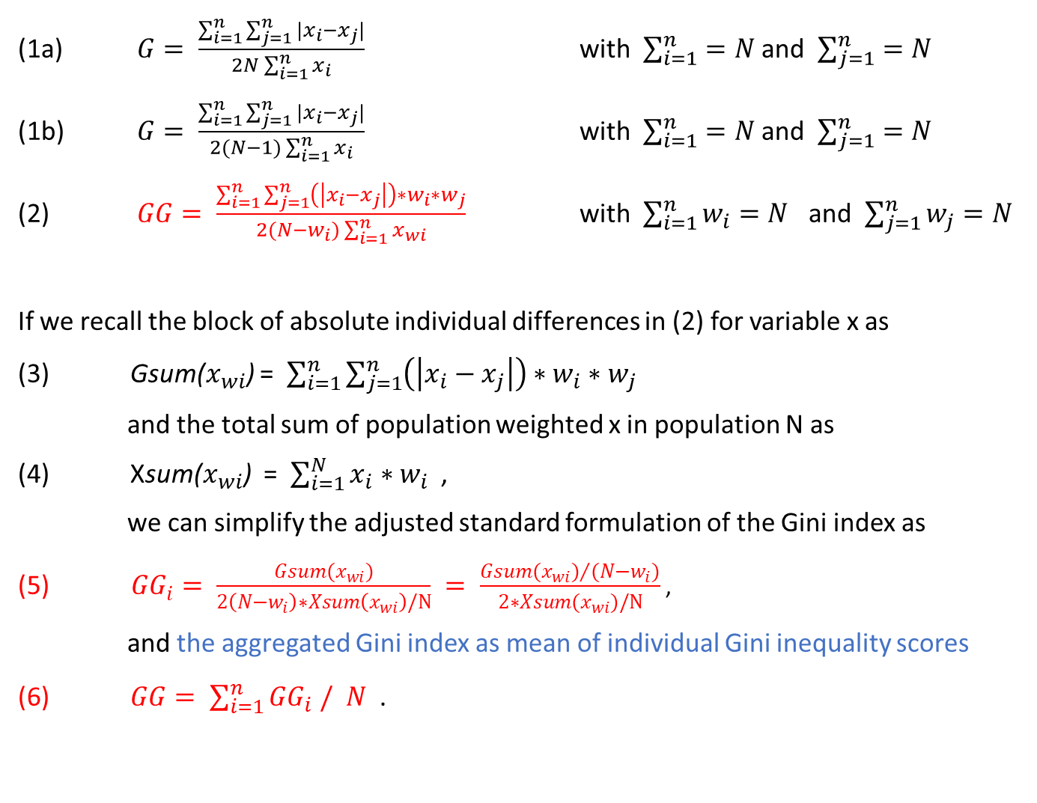
Mukhopadhyay/Sengupta 2021; Jedrzejczak 2008; Larraz et al. 2021
Gini-Index
(1a) $G= \frac{\sum_{i=1}^{n}{\sum_{j=1}^{n}{|x_{i}−x_{j}|}}}{2N\sum_{i=1}^{n}{x_{i}}}$ with $\sum_{i=1}^{n}{=N}$ and $\sum_{j=1}^{n}{=N}$
(1b) $G= \frac{\sum_{i=1}^{n}{\sum_{j=1}^{n}{|x_{i}−x_{j}|}}}{2(N−1)\sum_{i=1}^{n}{x_{i}}}$ with $\sum_{i=1}^{n}{=N}$ and $\sum_{j=1}^{n}{=N}$
(2) $GG= \frac{\sum_{i=1}^{n}{\sum_{j=1}^{n}{\left(\left|x_{i}−x_{j}\right|\right)∗w_{i}∗w_{j}}}}{2(N−w_{i})\sum_{i=1}^{n}{x_{wi}}}$ with $\sum_{i=1}^{n}{w_{i}=N}$ and $\sum_{j=1}^{n}{w_{j}=N}$
If we recall the block of absolute individual differences in (2) for variable x as
(3) Gsum($x_{wi}$) = $\sum_{i=1}^{n}{\sum_{j=1}^{n}{\left(\left|x_{i}−x_{j}\right|\right)∗w_{i}∗w_{j}}}$
and the total sum of population weighted x in population N as
(4) Xsum($x_{wi}$) = $\sum_{i=1}^{N}{x_{i}}∗w_{i}$ ,
we can simplify the adjusted standard formulation of the Gini index as
${GG}_{i}= \frac{Gsum(x_{wi})}{2\left(N−w_{i}\right)∗Xsum\left(x_{wi}\right)/N} = \frac{{Gsum(x_{wi})}/{(N−w_{i})}}{2∗Xsum(x_{wi})/N}$ ,
and the aggregated Gini index as mean of individual Gini inequality scores
(6) $GG= \sum_{i=1}^{n}{{GG}_{i} / N}$ .
Gini, Corrado (1936)
statistical (empirical) notation
geometric (Lorenz-type) notation
covariance notation
Inequality indicates differences in living conditions as tensions along the (vertical) rich-poor dimension,
whereas Diversity reflects (horizontal) between-group variations in ways of living.

Slide 28
Calculation of Gini (Sub-)Indices

Slide 29
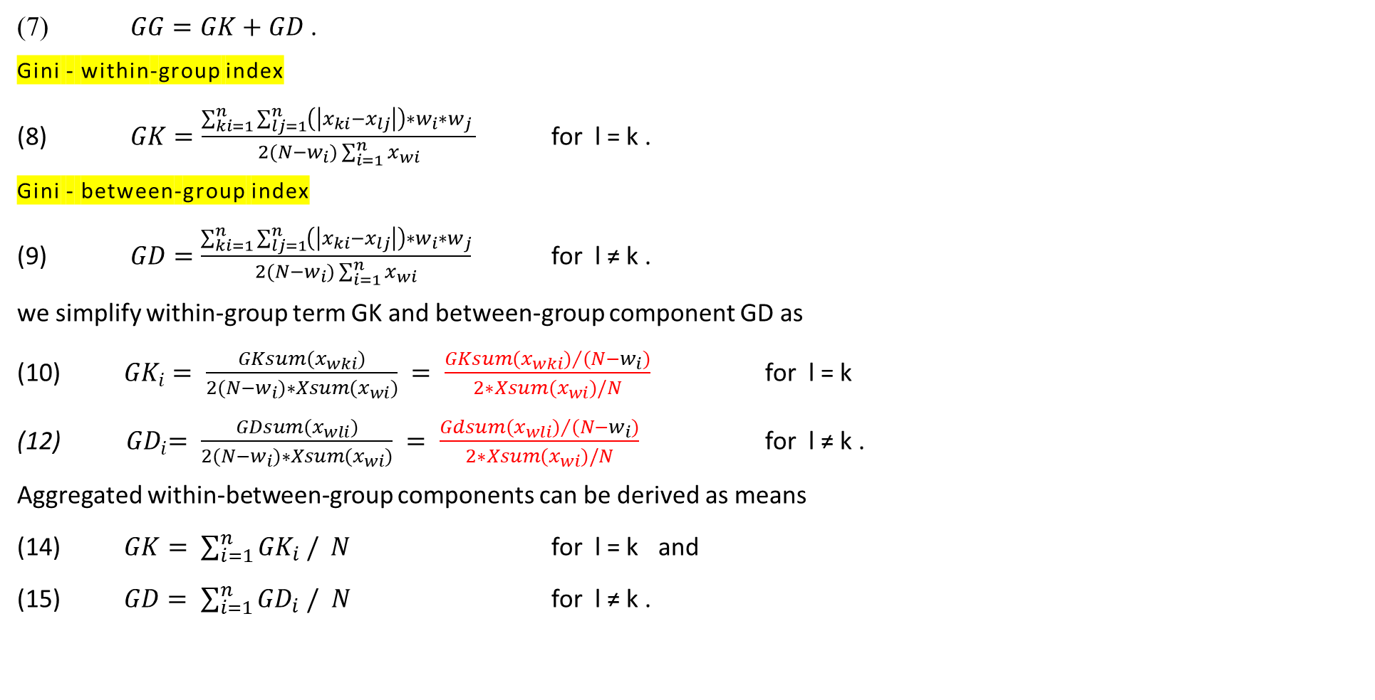
Within-group and between-group differentiations of the Gini coefficient
(7) $GG=GK+GD$.
Gini - within-group index
(8) $GK=\frac{\sum_{ki=1}^{n}{\sum_{lj=1}^{n}{\left(\left|x_{ki}−x_{lj}\right|\right)∗w_{i}∗w_{j}}} }{2(N−w_{i})\sum_{i=1}^{n}{x_{wi}}}$ for l = k .
Gini - between-group index
  (9) $GD=\frac{\sum_{ki=1}^{n}{\sum_{lj=1}^{n}{\left(\left|x_{ki}−x_{lj}\right|\right)∗w_{i}∗w_{j}}}}{2(N−w_{i})\sum_{i=1}^{n}{x_{wi}}}$ for l ≠ k .
we simplify within-group term GK and between-group component GD as
(10) ${GK}_{i}= \frac{GKsum(x_{wki})}{2(N−w_{i})∗Xsum(x_{wi})} = \frac{{GKsum(x_{wki})}/{(N−w_{i})}}{2∗Xsum(x_{wi})/N}$ for l = k
${ GD}_{i}= \frac{GDsum(x_{wli})}{2(N−w_{i})∗Xsum(x_{wi})} = \frac{{Gdsum(x_{wli})}/{(N−w_{i})}}{2∗Xsum(x_{wi})/N}$ for l ≠ k .
Aggregated within-between-group components can be derived as means
(14) $GK= \sum_{i=1}^{n}{{GK}_{i} / N}$ for l = k and
(15) $GD= \sum_{i=1}^{n}{{GD}_{i} / N}$ for l ≠ k .
Can we decompose Gini …
[factor decomposition]
by within-between-group
inequalities → yes
by adressing inequalities to
subgroups (without overlaps) → no
[subgroup decomposition]
by subgroup levels → yes
Yitzhaki 1994; Yitzhaki/Lerman 1991; Dagum 1980, Deutsch/Silber 1997; 1997a,b; Georgi 1999; Radaelli 2010; Costa 2008, 2021;

Slide 30
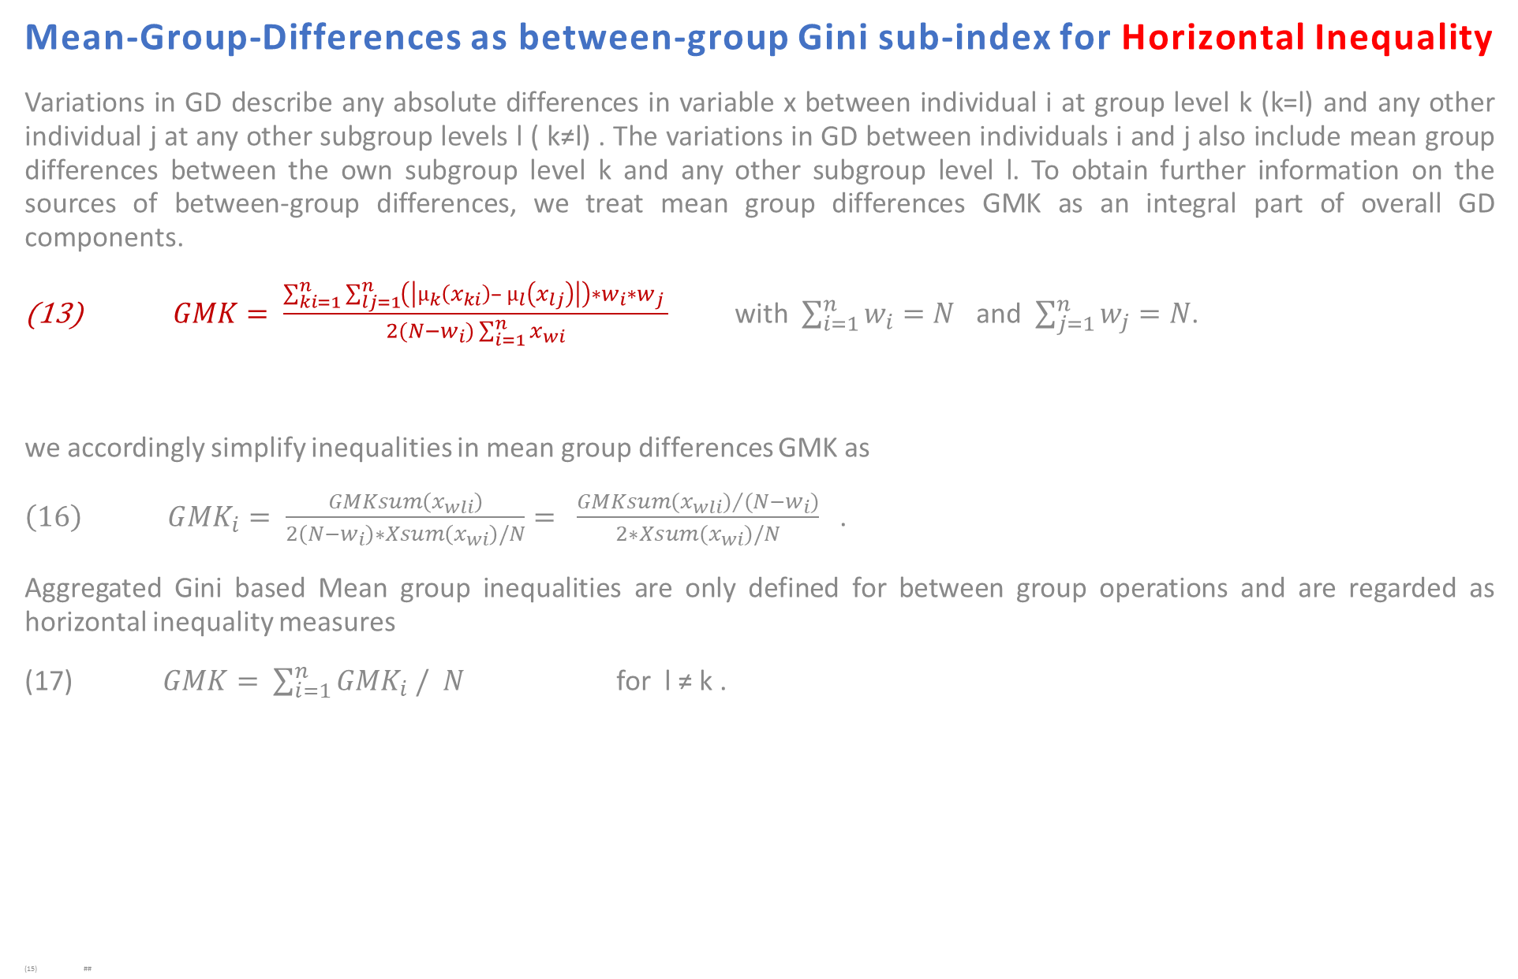
Mean-Group-Differences as between-group Gini sub-index for Horizontal Inequality
Variations in GD describe any absolute differences in variable x between individual i at group level k (k=l) and any other individual j at any other subgroup levels l ( k≠l) . The variations in GD between individuals i and j also include mean group differences between the own subgroup level k and any other subgroup level l. To obtain further information on the sources of between-group differences, we treat mean group differences GMK as an integral part of overall GD components.
$GMK= \frac{\sum_{ki=1}^{n}{\sum_{lj=1}^{n}{\left(\left|µ_{k}\left(x_{ki}\right)– µ_{l}\left(x_{lj}\right)\right|\right)∗w_{i}∗w_{j} }}}{2(N−w_{i})\sum_{i=1}^{n}{x_{wi}}}$ with $\sum_{i=1}^{n}{w_{i}=N}$ and $\sum_{j=1}^{n}{w_{j}=N}$.
we accordingly simplify inequalities in mean group differences GMK as
$\left(16\right) G{MK}_{i}= \frac{GMKsum\left(x_{wli}\right)}{2\left(N−w_{i}\right)∗Xsum\left(x_{wi}\right)/N}= \frac{{GMKsum(x_{wli})}/{(N−w_{i})}}{2∗Xsum(x_{wi})/N}$ .
Aggregated Gini based Mean group inequalities are only defined for between group operations and are regarded as horizontal inequality measures
(17) $GMK= \sum_{i=1}^{n}{{GMK}_{i} / N}$ for l ≠ k .
##
Bhattacharya/Mahalanobis 1967; Camelas/Gisselquist 2018,2019; Stewart 2005, 2009; Stewart et al. 2005, 2010.

Slide 31
Population Adjustments for Within- and Between-Group Gini SubIndices

Slide 32
M|K-dimensional Gini SubIndices

Slide 33
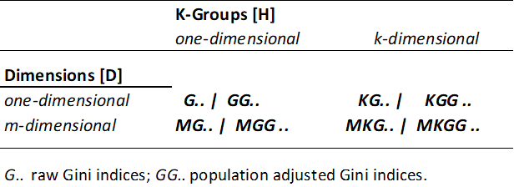
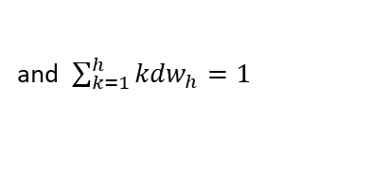
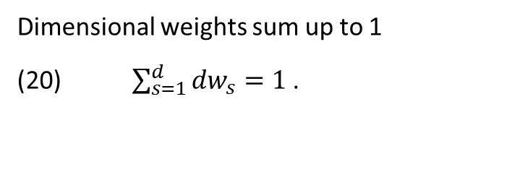
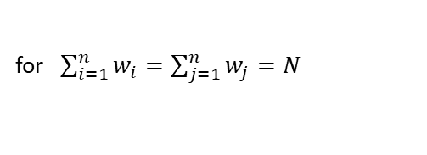
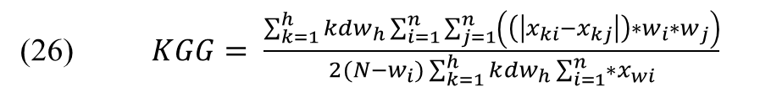
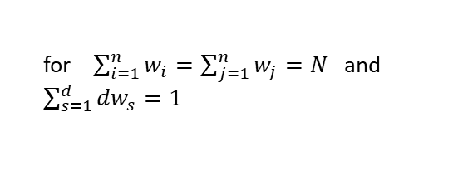
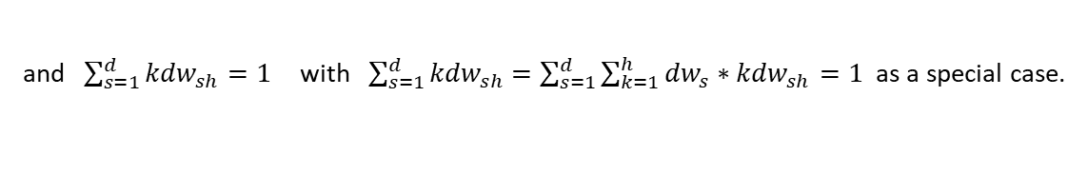
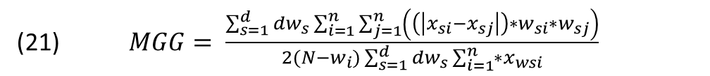
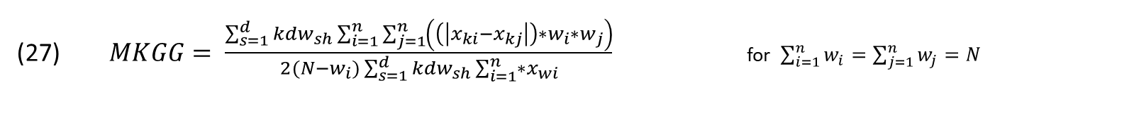
M|K-dimensional Applications of Gini Indices
Row-first approach by Decanq and Lugo (2012)
Dimensional weights sum up to 1
(20) $\sum_{s=1}^{d}{{dw}_{s}=1}$ .
(21) $MGG= \frac{\sum_{s=1}^{d}{{dw}_{s}}\sum_{i=1}^{n}{\sum_{j=1}^{n}{\left(\left(\left|x_{si}−x_{sj}\right|\right)∗w_{si}∗w_{sj}\right)}}}{2(N−w_{i})\sum_{s=1}^{d}{{dw}_{s}}\sum_{i=1}^{n}{∗x_{wsi}}}$
for $\sum_{i=1}^{n}{w_{i}=\sum_{j=1}^{n}{w_{j}=N}}$ and $\sum_{s=1}^{d}{{dw}_{s}=1 }$
(26) $KGG= \frac{\sum_{k=1}^{h}{{kdw}_{h}}\sum_{i=1}^{n}{\sum_{j=1}^{n}{\left(\left(\left|x_{ki}−x_{kj}\right|\right)∗w_{i}∗w_{j}\right)}}}{2(N−w_{i})\sum_{k=1}^{h}{k{dw}_{h}}\sum_{i=1}^{n}{∗x_{wi}}}$
for $\sum_{i=1}^{n}{w_{i}=\sum_{j=1}^{n}{w_{j}=N}}$
and $\sum_{k=1}^{h}{{kdw}_{h}=1 }$
$MKGG= \frac{\sum_{s=1}^{d}{{kdw}_{sh}}\sum_{i=1}^{n}{\sum_{j=1}^{n}{\left(\left(\left|x_{ki}−x_{kj}\right|\right)∗w_{i}∗w_{j}\right)}}}{2(N−w_{i})\sum_{s=1}^{d}{{kdw}_{sh}}\sum_{i=1}^{n}{∗x_{wi}}}$ for $\sum_{i=1}^{n}{w_{i}=\sum_{j=1}^{n}{w_{j}=N}}$
and $\sum_{s=1}^{d}{{kdw}_{sh}=1}$ with$\sum_{s=1}^{d}{{kdw}_{sh}}$ $=\sum_{s=1}^{d}{{\sum_{k=1}^{h}{{dw}_{s}}∗kdw}_{sh}=1}$ as a special case.

Slide 34
Population Adjustments for M|K-dimensional Gini SubIndices

Slide 35
Horizontal Inequalities

Slide 36
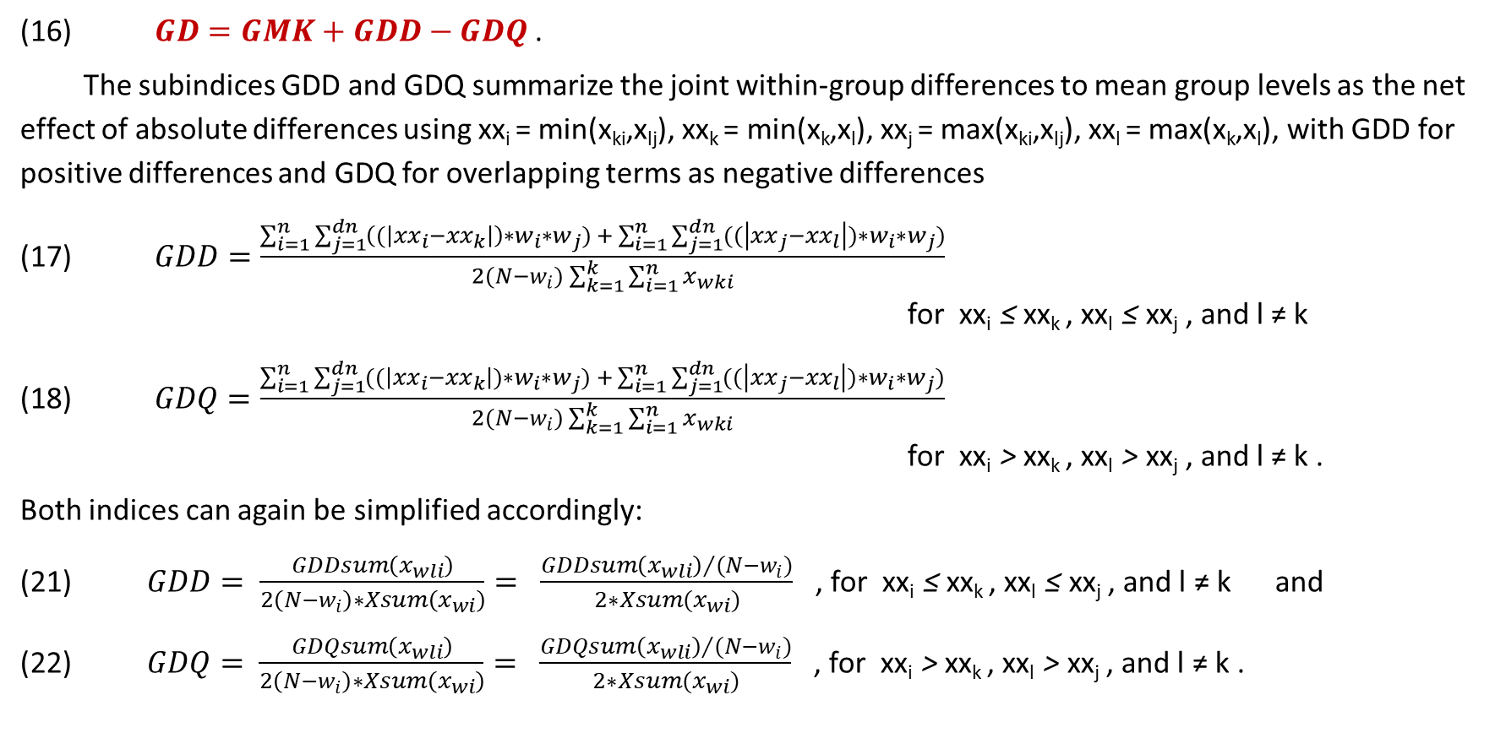
Between-Group-Related Decompositions of the Gini Coefficient I
(16) $GD=GMK+GDD−GDQ$ .
The subindices GDD and GDQ summarize the joint within-group differences to mean group levels as the net effect of absolute differences using xx_{i} = min(x_{ki},x_{lj}), xx_{k} = min(x_{k},x_{l}), xx_{j} = max(x_{ki},x_{lj}), xx_{l} = max(x_{k},x_{l}), with GDD for positive differences and GDQ for overlapping terms as negative differences
(17) $GDD=\frac{\sum_{i=1}^{n}{\sum_{j=1}^{dn}{\left((\left|xx_{i}−{xx}_{k}\right|\right)∗w_{i}∗w_{j}) + \sum_{i=1}^{n}{\sum_{j=1}^{dn}{((\left|xx_{j}−{xx}_{l}\right|)∗w_{i}∗w_{j})}}}}}{2(N−w_{i})\sum_{k=1}^{k}{\sum_{i=1}^{n}{x_{wki}}}}$
for xx_{i} ≤ xx_{k} , xx_{l} ≤ xx_{j} , and l ≠ k
(18) $GDQ=\frac{\sum_{i=1}^{n}{\sum_{j=1}^{dn}{((\left|xx_{i}−{xx}_{k}\right|)∗w_{i}∗w_{j}) + \sum_{i=1}^{n}{\sum_{j=1}^{dn}{((\left|xx_{j}−{xx}_{l}\right|)∗w_{i}∗w_{j})}}}}}{2(N−w_{i})\sum_{k=1}^{k}{\sum_{i=1}^{n}{x_{wki}}}}$
for xx_{i} > xx_{k} , xx_{l} > xx_{j} , and l ≠ k .
Both indices can again be simplified accordingly:
(21) $GDD= \frac{GDDsum\left(x_{wli}\right)}{2\left(N−w_{i}\right)∗Xsum\left(x_{wi}\right)}= \frac{{GDDsum\left(x_{wli}\right)}/{(N−w_{i})}}{2∗Xsum(x_{wi})}$ , for xx_{i} ≤ xx_{k} , xx_{l} ≤ xx_{j} , and l ≠ k and
(22) $GDQ= \frac{GDQsum\left(x_{wli}\right)}{2\left(N−w_{i}\right)∗Xsum\left(x_{wi}\right)}= \frac{{GDQsum\left(x_{wli}\right)}/{(N−w_{i})}}{2∗Xsum(x_{wi})}$ , for xx_{i} > xx_{k} , xx_{l} > xx_{j} , and l ≠ k .

Slide 37
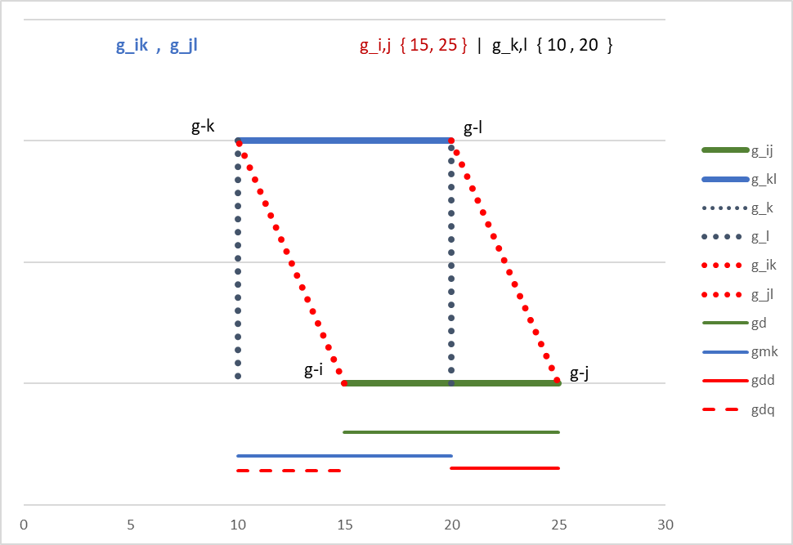
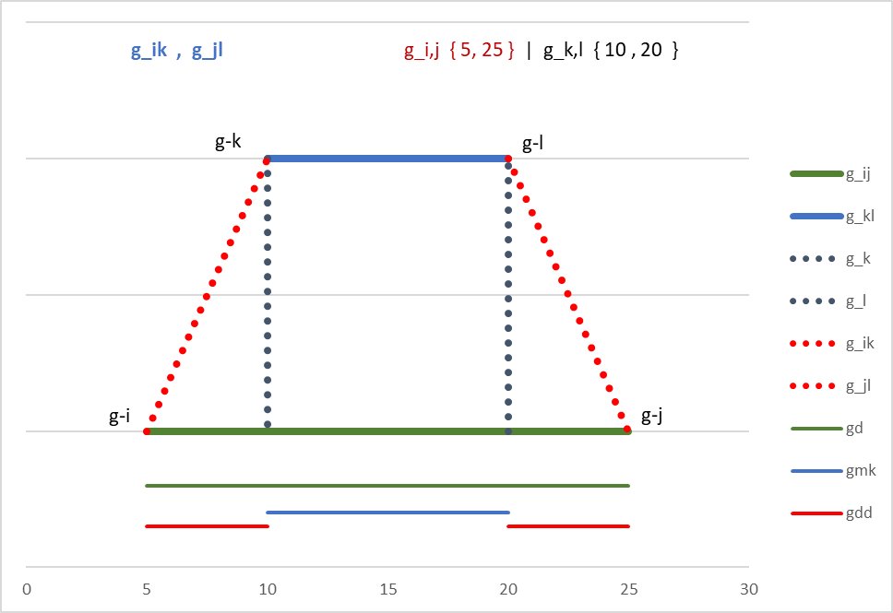
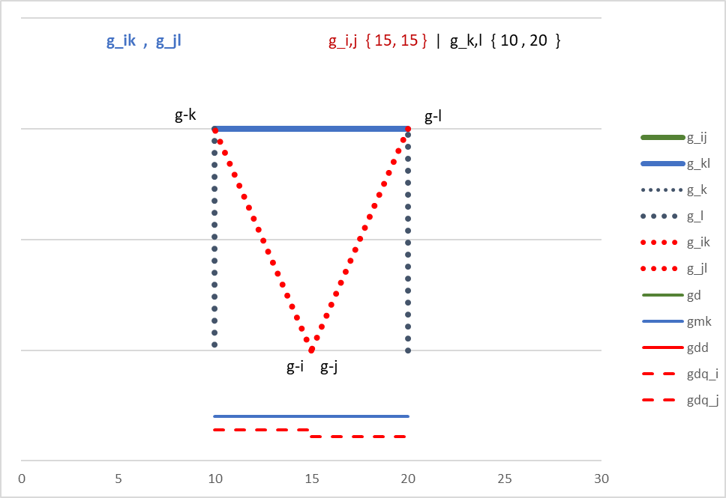
Between-Group-Related Decompositions of the Gini Coefficient
group level
individual level
$GD=GMK+GDD−GDQ$

Slide 38
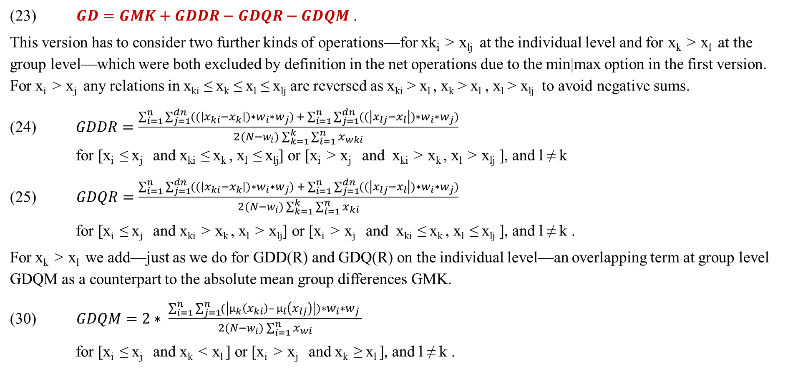
Between-Group-Related Decompositions of the Gini Coefficient II
(23) $GD=GMK+GDDR−GDQR−GDQM$ .
This version has to consider two further kinds of operations—for xk_{i} > x_{lj} at the individual level and for x_{k} > x_{l} at the group level—which were both excluded by definition in the net operations due to the min|max option in the first version. For x_{i} > x_{j} any relations in x_{ki} ≤ x_{k} ≤ x_{l} ≤ x_{lj} are reversed as x_{ki} > x_{l} , x_{k} > x_{l} , x_{l} > x_{lj} to avoid negative sums.
(24) $GDDR=\frac{\sum_{i=1}^{n}{\sum_{j=1}^{dn}{((\left|x_{ki}−x_{k}\right|)∗w_{i}∗w_{j}) + \sum_{i=1}^{n}{\sum_{j=1}^{dn}{((\left|x_{lj}−x_{l}\right|)∗w_{i}∗w_{j})}}}}}{2(N−w_{i})\sum_{k=1}^{k}{\sum_{i=1}^{n}{x_{wki}}}}$
for [x_{i} ≤ x_{j} and x_{ki} ≤ x_{k} , x_{l} ≤ x_{lj}] or [x_{i} > x_{j} and x_{ki} > x_{k} , x_{l} > x_{lj} ], and l ≠ k
(25) $GDQR=\frac{\sum_{i=1}^{n}{\sum_{j=1}^{dn}{((\left|x_{ki}−x_{k}\right|)∗w_{i}∗w_{j}) + \sum_{i=1}^{n}{\sum_{j=1}^{dn}{((\left|x_{lj}−x_{l}\right|)∗w_{i}∗w_{j})}}}}}{2(N−w_{i})\sum_{k=1}^{k}{\sum_{i=1}^{n}{x_{ki}}}}$
for [x_{i} ≤ x_{j} and x_{ki} > x_{k} , x_{l} > x_{lj}] or [x_{i} > x_{j} and x_{ki} ≤ x_{k} , x_{l} ≤ x_{lj} ], and l ≠ k .
For x_{k} > x_{l} we add—just as we do for GDD(R) and GDQ(R) on the individual level—an overlapping term at group level GDQM as a counterpart to the absolute mean group differences GMK.
(30) $GDQM=2∗ \frac{\sum_{i=1}^{n}{\sum_{j=1}^{n}{(\left|µ_{k}\left(x_{ki}\right)– µ_{l}\left(x_{lj}\right)\right|)∗w_{i}∗w_{j} }}}{2(N−w_{i})\sum_{i=1}^{n}{x_{wi}}}$
for [x_{i} ≤ x_{j} and x_{k} < x_{l} ] or [x_{i} > x_{j} and x_{k} ≥ x_{l} ], and l ≠ k .

Slide 39
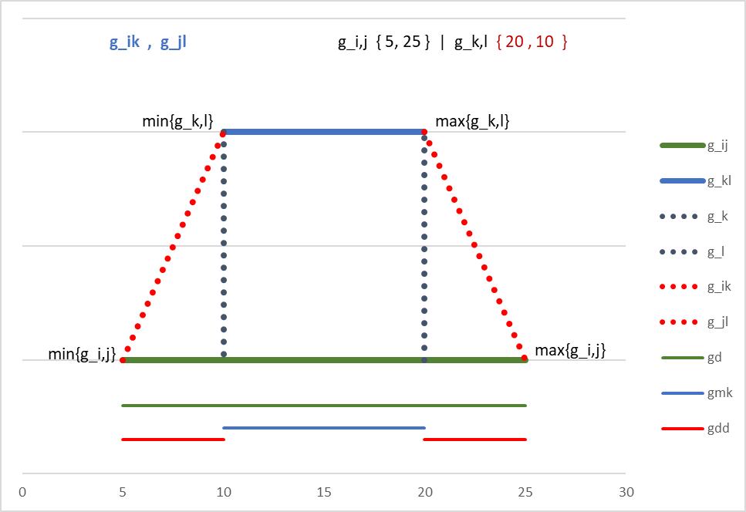
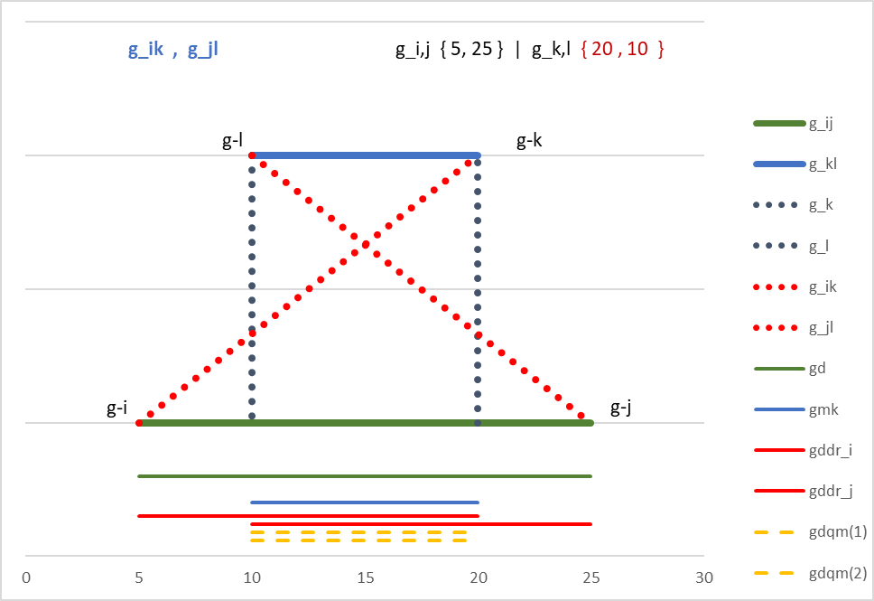
Between-Group-Related Decompositions of the Gini Coefficient
Version I
Version II
$GD=GMK+GDD−GDQ$
$GD=GMK+GDDR−GDQR −GDQM$

Slide 40
Diversity Indices - Between-Group-Related Gini sub-indices
For decomposition of between-group inequalities according to mean group levels, we mentioned two opposing joint individual within-group differences: GDD vs. GDQ for Version 1 and GDDR vs. GDQR for Version 2. Each of these components, which are all non-integral parts of the original Gini calculation, are sensitive to joint within-group variations, referring to each element of absolute individual differences across subgroups. GDD and GDQ (as well as GDDR and GDQR) together describe the full amount of joint within-group variation net of differences in mean group levels for each element of Gini calculation in different subgroups.
We indicate these inequality-based joint variations within different subgroup levels as diversity measures. For the calculation of Gini-based diversity indices, we use both versions of joint within-group differences to mean group levels (GDD, GDQ and GDDR, GDQR).
The resulting Gini-based diversity indices GDIV1 and GDIV2 can thus be regarded as further Gini-based subindices as well.
(33) $GDIV1=GDD+GDQ$ for l ≠ k
(37) $GDIV2=GDDR+GDQ$R for l ≠ k

Slide 41
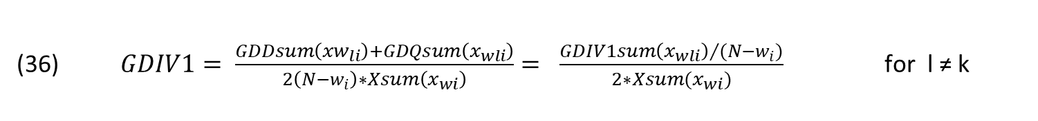
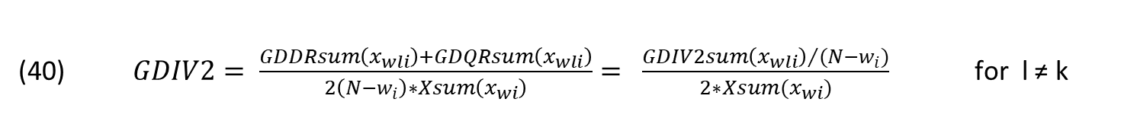
Diversity Indices - GDIV1 GDIV2
GDIV1 may be regarded as a lower bound in overall diversities, assuming full reports of within-group variation by each individual i and j from different subgroups k and l. GDIV1 is conceptualized as the net effect of absolute differences using xx_{i} = min(x_{ki},x_{lj}), xx_{k} = min(x_{k},x_{l}), xx_{j} = max(x_{ki},x_{lj}), xx_{l} = max(x_{k},x_{l}). Differences in individual levels x_{ki} and x_{lj} as well as the related differences in group levels x_{k} and x_{l} are fully recognized by each other and therefore interchangeable between any individuals i and j.
(34) $GDIV1=\frac{\sum_{i=1}^{n}{\sum_{j=1}^{dn}{((\left|xx_{i}−{xx}_{k}\right|)∗w_{i}∗w_{j} ) + \sum_{i=1}^{n}{\sum_{j=1}^{dn}{((\left|xx_{j}−{xx}_{l}\right|)∗w_{i}∗w_{j} )}}}}}{2(N−1)\sum_{k=1}^{k}{\sum_{i=1}^{n}{x_{wki}}}}$ for l ≠ k
(36) $GDIV1= \frac{GDDsum\left({xw}_{li}\right)+GDQsum\left(x_{wli}\right)}{2\left(N−w_{i}\right)∗Xsum\left(x_{wi}\right)}= \frac{{GDIV1sum\left(x_{wli}\right)}/{(N−w_{i})}}{2∗Xsum(x_{wi})}$ for l ≠ k
GDIV2 marks upper bounds in inequality-based diversities between each pair of individuals i and j from different subgroups k and l. This specification assumes that each of the individuals refers primarily to their own subgroup level and takes further notice of variations in subgroup-related differences of other individuals to their subgroup level.
(38) $GDIV2=\frac{\sum_{i=1}^{n}{\sum_{j=1}^{dn}{((\left|x_{ki}−x_{k}\right|)∗w_{i}∗w_{j}) + \sum_{i=1}^{n}{\sum_{j=1}^{dn}{((\left|x_{j}−x_{lj}\right|)∗w_{i}∗w_{j})}}}}}{2(N−w_{i})\sum_{k=1}^{k}{\sum_{i=1}^{n}{x_{wi}}}}$ for l ≠ k
(40) $GDIV2= \frac{GDDRsum\left(x_{wli}\right)+GDQRsum\left(x_{wli}\right)}{2\left(N−w_{i}\right)∗Xsum\left(x_{wi}\right)}= \frac{{GDIV2sum\left(x_{wli}\right)}/{(N−w_{i})}}{2∗Xsum(x_{wi})}$ for l ≠ k

Slide 42
Population Adjustments for Gini based Diversity Indices

Slide 43
M|K-dimensional Gini-based (Sub-)Indices
For multidimensional applications of Gini subindices and diversity indices, we follow the row-first approach by Decanq and Lugo (2012) and others. Any Gini index can, according to this approach, be reassigned as a multidimensional index using dimensional weighting with sum of dimensional weights (dw) = 1. The dimensional weights specify the percentage to which each dimension (or variable) s contributes to the supposed overall inequality across dimensions.
A standard approach is to use equal weights or any design-based variable assignments. We also propose the use of welfare-based individual weighting schemes, as dimensional priorities may vary between individuals and may change during the life cycle.
Maasoumi 1986; Decanq/Lugo 2012
Any of the previously differentiated raw [G.. {GK,GD,GKM,GDD*,GDQ*} ] and population-adjusted [GG.. {GGK,GGD,GGKM,GGDD*,GGDQ*}] Gini subindices can accordingly be assigned for multidimensional applications as M|K|G… and M|K|GG… .

Slide 44
Programs
[4] Programs and tools for multidimensional well-being applications
4.1 MPPIS | MWWIS – Multidimensional Deprivation and WellBeing
4.2 MGDIV – Multidimensional Inequalities [Gini]
4.3 Tools – Dimensional Weighting | Rescaling

Slide 45
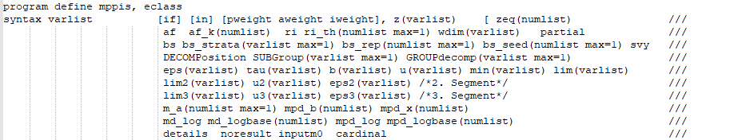

Programs MPPIS | MWWIS – multi-dimensional Deprivation & WellBeing

Slide 46
Programs MPPIS - multi-dimensional Deprivation
program define mppis, eclass
syntax varlist [if] [in] [pweight aweight iweight], z(varlist) [ zeq(numlist) /// af af_k(numlist) ri ri_th(numlist max=1) wdim(varlist) partial /// bs bs_strata(varlist max=1) bs_rep(numlist max=1) bs_seed(numlist max=1) svy /// DECOMPosition SUBGroup(varlist max=1) GROUPdecomp(varlist max=1) /// eps(varlist) tau(varlist) b(varlist) u(varlist) min(varlist) lim(varlist) /// lim2(varlist) u2(varlist) eps2(varlist) /*2. Segment*/ /// lim3(varlist) u3(varlist) eps3(varlist) /*3. Segment*/ /// m_a(numlist max=1) mpd_b(numlist) mpd_x(numlist) /// md_log md_logbase(numlist) mpd_log mpd_logbase(numlist) /// details noresult inputm0 cardinal ///
vmd_h vmd_h1 vmd_h0 vmd_md vmd_hc vmd_m0c vmd_m1c vmd_mac /// vmpd_h vmpd_h1 vmpd_h0 vmpd_md vmpd_hc vmpd_m0c vmpd_m1c vmpd_mac /// vmd_m0th vmd_m1th vmd_math vmpd_m0th vmpd_m1th vmpd_math /// vmd_h_name(string) vmd_h1_name(string) vmd_h0_name(string) vmd_md_name(string) /// vmpd_h_name(string) vmpd_h1_name(string) vmpd_h0_name(string) vmpd_md_name(string) /// vmd_hc_name(string) vmd_m0c_name(string) vmd_m1c_name(string) vmd_mac_name(string) /// vmpd_hc_name(string) vmpd_m0c_name(string) vmpd_m1c_name(string) vmpd_mac_name(string) /// vmd_m0th_name(string) vmd_m1th_name(string) vmd_math_name(string) /// vmpd_m0th_name(string) vmpd_m1th_name(string) vmpd_math_name(string) /// vdim_d0(string) vdim_d1(string) vdim_da(string) ]

Slide 47



Slide 50


Slide 51
Programs MWWIS - multi-dimensional WellBeing
program define mwwis, eclass
syntax varlist [if] [in] [pweight aweight iweight], w(varlist) [ weq(numlist) /// af af_k(numlist) ri ri_th(numlist max=1) wdim(varlist) partial /// bs bs_strata(varlist max=1) bs_rep(numlist max=1) bs_seed(numlist max=1) svy /// DECOMPosition SUBGroup(varlist max=1) GROUPdecomp(varlist max=1) /// eps(varlist) tau(varlist) q(varlist) l(varlist) max(varlist) lim(varlist) /// lim2(varlist) l2(varlist) eps2(varlist) /*2. Segment*/ /// lim3(varlist) l3(varlist) eps3(varlist) /*3. Segment*/ /// m_a(numlist max=1) mpw_q(numlist) mpw_x(numlist) /// mw_log mw_logbase(numlist) mpw_log mpw_logbase(numlist) /// details noresult inputm0 cardinal ///
vmw_h vmw_h1 vmw_h0 vmw_mw vmw_hc vmw_m0c vmw_m1c vmw_mac /// vmpw_h vmpw_h1 vmpw_h0 vmpw_mw vmpw_hc vmpw_m0c vmpw_m1c vmpw_mac /// vmw_m0th vmw_m1th vmw_math vmpw_m0th vmpw_m1th vmpw_math /// vmw_h_name(string) vmw_h1_name(string) vmw_h0_name(string) vmw_mw_name(string) /// vmpw_h_name(string) vmpw_h1_name(string) vmpw_h0_name(string) vmpw_mw_name(string) /// vmw_hc_name(string) vmw_m0c_name(string) vmw_m1c_name(string) vmw_mac_name(string) /// vmpw_hc_name(string) vmpw_m0c_name(string) vmpw_m1c_name(string) vmpw_mac_name(string) /// vmw_m0th_name(string) vmw_m1th_name(string) vmw_math_name(string) /// vmpw_m0th_name(string) vmpw_m1th_name(string) vmpw_math_name(string) /// vdim_w0(string) vdim_w1(string) vdim_wa(string) ]

Slide 52
Programs MWWIS - multi-dimensional WellBeing
program define mwwis, eclass
syntax varlist [if] [in] [pweight aweight iweight], w(varlist) [ weq(numlist) /// af af_k(numlist) ri ri_th(numlist max=1) wdim(varlist) partial /// bs bs_strata(varlist max=1) bs_rep(numlist max=1) bs_seed(numlist max=1) svy /// DECOMPosition SUBGroup(varlist max=1) GROUPdecomp(varlist max=1) /// eps(varlist) tau(varlist) q(varlist) l(varlist) max(varlist) lim(varlist) /// lim2(varlist) l2(varlist) eps2(varlist) /*2. Segment*/ /// lim3(varlist) l3(varlist) eps3(varlist) /*3. Segment*/ /// m_a(numlist max=1) mpw_q(numlist) mpw_x(numlist) /// mw_log mw_logbase(numlist) mpw_log mpw_logbase(numlist) /// details noresult inputm0 cardinal ///
vmw_h vmw_h1 vmw_h0 vmw_mw vmw_hc vmw_m0c vmw_m1c vmw_mac /// vmpw_h vmpw_h1 vmpw_h0 vmpw_mw vmpw_hc vmpw_m0c vmpw_m1c vmpw_mac /// vmw_m0th vmw_m1th vmw_math vmpw_m0th vmpw_m1th vmpw_math /// vmw_h_name(string) vmw_h1_name(string) vmw_h0_name(string) vmw_mw_name(string) /// vmpw_h_name(string) vmpw_h1_name(string) vmpw_h0_name(string) vmpw_mw_name(string) /// vmw_hc_name(string) vmw_m0c_name(string) vmw_m1c_name(string) vmw_mac_name(string) /// vmpw_hc_name(string) vmpw_m0c_name(string) vmpw_m1c_name(string) vmpw_mac_name(string) /// vmw_m0th_name(string) vmw_m1th_name(string) vmw_math_name(string) /// vmpw_m0th_name(string) vmpw_m1th_name(string) vmpw_math_name(string) /// vdim_w0(string) vdim_w1(string) vdim_wa(string) ]

Slide 53
Programs MPPIS [MWWIS with similar options]
** multidimensional applications [default: af ]
* af [def] : Alkire, S. and J. Foster (2011). Counting and multidimensional poverty measurement.
* Journal of Public Economics 95(7-8), 476–487.
* af_k [def 33.3 {0.333] : dual-cutoff threshold [pcutoff] - percentage of dimensions to indicate as m-poor
* ri [] : ri, Nicole Rippin (2013). Considerations of Efficiency and Distributive Justice
* in Multidimensional Poverty Measurement. Dissertation(Göttingen).
* ri_th [def 2.0] : Theta parameter to shape identification across dimensions
** definitions of lines {dimensional cutoffs} -- mppis vs mwwis
* z deprivation line(s) || w wealth line(s)
* u upper deprivation line(s) || l lower wealth line(s)
* b ratio u/z {b>1} || q ratio l/w {q<1}
* partial [def (no)] : parameter to initialize pd-function
* tau [default gen] : parameter for baseline pd-function
* eps [default 1.0] : parameter to shape pd-function
* b [default gen] : parameter for ratio u/z in pd-function
* u [input expected] : upper bound for zones of deprivation in pd-function
* lim [default 0.01] : supposed pd-value at u {~marginal > 0}
* m_pdb [default 2.0] : integration parameter - for standard and partial fgt-gaps
m_pdx [default 0] : integration parameter - to consider only partial fgt-gaps [1: standard gaps = 0]
* eps2 eps3 : eps parameter for 2.|3. segment
* u2 u3 : u parameter for 2.|3. segment
lim2 lim3 : lim parameter for 2.|3. segment
* min [default 0] : min coding - used also for m-fgt-adjustments
* cardinal [def no] : option for m-fgt-applications {mdM1,..,mdMa}
* m_a [default 2.0] : parameter alpha - for m-fgt-functions -- by default: {mdMa[2]}
* zeq [def 0: var < z] : option for z-line { 1: var <= z }
* details [def no] : option for listing of parameter settings in pd-functions

Slide 54
Programs MGDIV - multi-dimensional Gini
syntax varlist [if] [in] [fweight aweight pweight], [ggg gdd gdiv ddiv gmax gmax1 ///
SUBGroup(varlist max=1) hgroup(varlist) kdim mkdim nogg ///
klevel(string) kklevel(string) wdimh(varlist) wdimhd(varlist) skdecomp kkdecomp ///
mdim wdimd(varlist) mgdecomp kgdecomp mkgdecomp decomp_pop decomp_tot ///
decomp_pct mbeta beta(numlist max=1) vdelta delta(numlist max=1) vout ///
vmout vmoutdim vkout vkoutdim vmkout vmkoutdim vpre(string) vsuf(string) ]
// options
// ggg calculate and display GG [GN] GK GD GMK GGK GGD GGMK
// gdd calculate and display decompostions of GD|GDD [GDIV1: GDD GDQ | GDIV2: GDDR GDDQ GDQM | ...]
// gdiv calculate and display GDIV1,2,... | GGDIV1,2,...
// *ddiv calculate and display decompostions of GDIV1,2,... | GGDIV1,2,... //not yet implemented
// subgroup(var) subgroup variable for subgroup decomposition
// hgroup(var) hgroup variable for factor decomposition (within-between & [mean] group {GK GD GMK | GGK GGD GGMK | GDIV.. } )
// skdecomp subgroup decomposition by [subgroup]
// kkdecomp subgroup decomposition(s) by [hgroup(s)]
// mdim apply multidimensional calculation
// kdim apply k-dimensional calculation
// mkdim apply multidimensional and k-dimensional calculation
// wdimd(varlist) list of variables for m-dimensional weighting [n of elements = ndim]
// wdimh(varlist) list of variables for k-dimensional weighting [n of elements = nhdim (nk1,nk2,...,nkn)]
// mgdecomp multidimensional factor decomposition by dimension [varlist]
// kgdecomp k-dimensional factor decomposition by k-dimension [klist]
// mkgdecomp multidimensional and k-dimensional factor decomposition by k-dimension and dimension [k-list * varlist]
// decomp_pop display results of subgroup decomposition by subgroup levels
// decomp_tot display results of decomposition as absolute contributions [default]
// decomp_pct display results of decomposition as percentage contributions
// output-options
// vout save individual m-k-versions [before final aggregation{mean}] of all calculated single Sub-Indices
// vmout save individual k-versions [before final aggregation{mean}] of all calculated m-dimensional Sub-Indices
// vmoutdim save individual m-k-versions [before final aggregation{mean}] of all calculated m-dimensional Sub-Indices
// vkout save individual m-versions [before final aggregation{mean}] of all calculated k-dimensional Sub-Indices
// vkoutdim save individual m-k-versions [before final aggregation{mean}] of all calculated k-dimensional Sub-Indices
// vmkout save individual versions [before final aggregation{mean}] of all calculated m-k-dimensional Sub-Indices
// vmkoutdim save individual m-k-versions [before final aggregation{mean}] of all calculated m-k-dimensional Sub-Indices

Slide 55
Tools
[4.3] Tools for multidimensional weighting | rescaling
a WDim – Design weights | regression for (individual) empirical components
b WDim – Aggregation | Smoothing | Output-Options {Design|Strength|Variation|Correlation}
c Rescale – (Options - Min-Max | Out-Scale)

Slide 56
ww0 design weights {normative}
wwd dimensional wgts {reg r2_a}
wwi individual wgts {reg predict}
wwf correlation {reg vif}
Programs Dimwgt - multi-dimensional weighting
All dim-wgts | components are normalized {0,…,1}
Default: www [ww0*wwd*wwi*wwf]
Default: wwz [www - smoothed]
program define dimwgt
syntax varlist [if] [in] [pweight aweight iweight] , idvar(varlist) yvar(varlist) ///
[ covari(varlist) covarc(varlist) hvar(varlist) ///
ddesignv(varlist) ddesign(numlist) hdesignv(varlist) hdesign(numlist) wwx(string) ///
smf(real 1000) details dwout dwouthd dwout2 dwoutall dwpre(string) dwsuf(string) minNk(real 100) ]
* *** input options
* *** idvar ids - used to link with frames
* *** pwgt [individual] weights -- provided as analytical and proportional weights [aw,pw]
* *** yvar (continuous) well-being indicators - used as dependent variables in regression [OLS]
* *** covari (integer) well-being indicators - used as independent variables in regression [OLS]
* *** covarc (continuous) well-being indicators - used as independent variables in regression [OLS]
* *** hvar (integer) well-being indicators - used as grouping variable –
regression is processed for each group level[k] seperately
* *** xdesign (vars scores) external variables with dimensional design weights
* *** design (scores) internal dimensional design weights
* *** smf (value) smoothing factor [ ln(var * smf) ] default smf = 1000
* *** minNk (value) minimal N [of subgroup-level] to be considered for subgroup estimates
default minNk = 100
(for n [of k] < 100 -- dimension estimates without subgroup differentiation are applied)
* *** wwx (value) own selection of components [ww0|wwd|wwi|wwf]

Slide 57
Programs Rescale – Rescaling of variables
program define rescale
syntax varlist [if] [in] , [vmin(numlist) vmax(numlist) outmin(numlist) outmax(numlist) ///
vpre(string) vsuf(string) vvn vvo vct0 vct1 ]
* *** options
* *** vmin bottom coding (before rescaling)
* *** vmax top coding (before rescaling)
* *** outmin assigned minimum value of outvar
* *** outmax assigned maximum value of outvar
* *** vvn output of normalized outvar {0,…,1}
* *** vvo output of designed outvar {vmin,…,vmax}
* *** vct0 output of standardized outvar {0,…,100}
* *** vct1 output of standardized outvar {1,…,100}

Slide 58
Outlook | Discussion
[5] Outlook | Discussion
5.1 Conception – providing structured data for well-being monitoring
5.2 Programs – adjustments | help files - description
5.3 TimeTable – beta-release by September/October – release by December 2024

Slide 59
5.1 Conception – providing structured data for well-being monitoring
Why Multi-dimensional WellBeing Applications?
Identifying individual overlaps in well-being indicators {across conception levels}
Identifying shifts in multiple deprivations | well-beings | inequalities of entire population
{for opinion dynamics}
Providing structured (output) indicators for statistical (regression) analyses {individual scores}
Are results from multi-dimensional well-being applications more robust or more volatile [over time] than one-dimensional results?
5.2 Programs – adjustments | help files - description
5.3 TimeTable – beta-release by September/October –
release by December 2024

Slide 60
Thank You

Slide 61


Living conditions in urban areas differ from those in rural areas in the much higher density of the population on the one hand and the greater (multi-faceted) [group] diversity on the other.
Urban inequalities are closely related to urban
→ Subgroup diversities. [Krause (2023/24) forthcoming]
1500 - 2021
1960 - 2020

Slide 62
Fuzzy Zones of Precarity
Fuzzy Zones of Prosperity
Fixed-Fuzzy-Approach
Degrees (Partial) Deprivation
select indicator(s) [dimension]
define fuzzy zones of prosperity [w, l]
extract degrees of wealth
run counting approach
Degrees (Partial) Wealth
select indicator(s) [dimension]
define fuzzy zones of precarity [z, u]
extract degrees of deprivation
run counting approach
[Krause (2019; 2023/24) forthcoming]

Slide 63
[Urban] inequalities are closely related to [urban] → Subgroup diversities.
Inequality indicates differences in living conditions as tensions between having and not-having along the (vertical) rich-poor dimension,
whereas Diversity reflects (horizontal) between-group variations in ways of living.
Diversities may be characterized – in contrast to horizontal inequalities –
as common variations in (multi-dimensional) well-being(s).

Slide 64
Methods – Gini-based Indices
[2] Methods – Gini Indices: Inequality and Diversity
2.1 Gini-based inequality(ies) | within-between-group decompositions
2.2 Gini-based diversity(ies)

Slide 65
Data and Indicators
[3] Data and Indicators – SOEP | Indicators, Design
3.1 Database SOEP
3.2 Key variables
3.3 Indicators and design

Slide 66
Database German Socio-Economic Panel (SOEP)
For the empirical analyses of urban development, we use the German Socio-Economic Panel (SOEPv37), with its 1,052,596 (continuous) individual observations over the period 1984 to 2020, which is approximately 15,000 to 50,000 annual observations of individuals in private households per year.
The SOEP is a representative longitudinal scientific survey launched in West Germany in 1984 (Wagner, Frick, Schupp 2007). Every year since then, in each SOEP household, a personal interview has been conducted with each individual aged 16 and older. In addition, a household questionnaire is completed by the head of the household or the household member who knows the most about household matters. All households and adult household members are surveyed annually through personal interviews. The main topics covered in the questionnaire are demographics as well as indicators of living conditions, including economic welfare and satisfaction with life (happiness) and different life domains.
Differentiated information is collected on personal and household incomes and further indicators of wealth, housing, labor market issues, health, and leisure (Goebel et al. 2018; Gießelmann et al. 2019). The SOEP was extended to cover the East German population in 1990, so that the transformation of living conditions following unification can be analyzed from the beginning of this process.
SOEPv35, doi:10.5684/soep.v37.

Slide 67
Individual well-being: For unidimensional analyses, we concentrate on economic and subjective well-being.
Economic well-being
  Annual household net equivalent incomes (annual previous year incomes at 2020 price levels, adjusted at income-years (t-1); revised OECD scale)
Subjective well-being
  Life satisfaction (0-10 scale, 0 = completely dissatisfied, 10 = completely satisfied)
  — both measures are further used as key variables
  to derive (individual) multi-dimensional weighting schemes

Slide 68

Multidimensional Economic Well-Being
The indicator design defines the reference frame for the analyses; open cells (without indicators) are not considered for interpretation. Cells with several indicators are accordingly down-weighted.
Total population; Satisfaction scores for children are derived from (both) parents|responsible household members.

Slide 69
Generalized well-being applications
First, we distinguish (in the tradition of Maslow, 1946) two types of basic needs dimensions—(daily) life and home—as absolute necessities.
Social Reporting: objective and subjective well-being indicators (Glatzer, Zapf 1984)
Social Indicators perspectives for micro, meso, and macro aggregation levels (Noll 2018).
Socio-ecological perspective of interrelated ecological spheres (Bronfenbrenner 1979)
The following three types of economic, social, and cultural well-being resources reflect Pierre Bourdieu’s (1986) capital differentiation on the one hand, and Erik Allardt’s (1993) distinction between having, loving, and being on the other.
Each dimension is further differentiated by subdimensions – for positive aims and negative avoidances (loss aversion).

Slide 70
Individual Multidimensional Weighting Scheme and Rescaling

Slide 72
Results
[4] Results – Urban Population | Income, Multi-dimensional (Economic) Well-Being
4.1 AF Fixed-fuzzy-approach for deprivation(s) and well-being(s)
4.2 Gini-based inequality(ies) and diversity(ies)

Slide 73


HH-Net-eq.Income
Life Satisfaction

Slide 74

Deprivation and Well-Being
HH-Net-Eq.Incomes

Slide 75
Inequality and Diversity
HH-Net-Eq.Incomes

Slide 76
Inequality and Diversity
HH-Net-Eq.Incomes

Slide 77

M-Dim Economic Resources – Deprivation and Well-Being [standard and fixed-fuzzy approach, AF]
SOEPv37 [2017; total population]

Slide 78




M-Dim Economic Resources – inequalities and diversities [Gini-based sub-indices]
SOEPv37 [2017; total population]

Slide 79




M-Dim General Resources – Deprivation and Well-Being [standard and fixed-fuzzy approach]
SOEPv37 [2017; adult population]

Slide 80



M-Dim General Resources – inequalities and diversities [Gini-based sub-indices]
SOEPv37 [2017; adult population]

Slide 81
Discussion
[5] Discussion – Emergence of urban inequalities and diversities in Germany
5.1 Urban Inequalities and Diversities

Slide 82
Empirical results on urban-rural inequalities in Germany
In summary, our results confirm several regional differences, especially when considering deprivation and economic well-being in East Germany, but show almost no systematic variations in inequality or diversity in our urban categories—large cities, other urban areas, and rural areas—in and across regions. Several Gini-based subindices indicate instead, for all unidimensional and multidimensional settings, high diversity-related overlaps in distributions, with similar pictures of within- and between-group variation and low mean group differences. Living conditions in Germany are thus not really divided by differences between large cities, other urban areas, and rural areas.
Instead, we observe higher degrees of inequality over time—also within each kind of urban and rural area: Large cities display substantial internal variation between rich and poor parts of the city; economic levels differ between urban and suburban areas; and rural towns and municipalities are very heterogenous (economically).

Slide 83
Gini-based Diversities …
… need further (empirical and methodological) checks
… re-adress [between-group] inequalities as joint variations across social groups
… point to our notion as group members in social interactions
… and may be related to our collective capabilities to manage our (collective) identities and (social) roles

Slide 84
Thank You

Slide 85
Methods
  Methods - Partial Deprivation and Partial Wealth
    Identification of (Partial) Deprivation and Wealth
    Aggregation of (Partial) Deprivation and Wealth

Slide 86
Following Sen (1976) we face two general steps in the measurement of deprivation … . First we have to choose indicators and to set up thresholds to identify someone as poor – the identification step. Second we have to set up measures to account for the incidence, intensity and inequality of poverty – the aggregation step.
This presentation offers a counting approach for the identification of partial deprivation and partial wealth –
… and it‘s aggregation according to the well-established FGT-Measures, as proposed by Foster/Greer/Thorbecke (1984; 2010)

Slide 87
Fuzzy Zones of Precarity
Fuzzy Zones of Prosperity
Degrees (Partial) Deprivation
select indicator(s) [dimension]
define fuzzy zones of prosperity [w, l]
extract degrees of wealth
run counting approach
Degrees (Partial) Wealth
select indicator(s) [dimension]
define fuzzy zones of precarity [z, u]
extract degrees of deprivation
run counting approach

Slide 88
Identification of Partial Deprivation
Identification of Partial Wealth

Slide 89


[1] Identification of Poverty
[1] Identification of Wealth
${hz}_{i}=1$ if $y_{i }<z$
${hz}_{i}=0$ if $y_{i }≥z$
with
$y_{i }$ individual indicator for poverty
$z$ poverty threshold
${hz}_{i}$ individual poverty score [0, 1]
${hw}_{i}=1$ if $x_{i }> w$
${hw}_{i}=0$ if $x_{i }≤w$
with
$x_{i }$ individual indicator for wealth
$w$ wealth threshold
${hw}_{i}$ individual wealth score [0, 1]

Slide 90
[2] Identification of Partial Deprivation
[2] Identification of Partial Wealth
$${pd}_{i}=exp\left\{ε\left[1−{\left(\frac{y_{i}}{z}\right)}^{τ\left[\left(\frac{y_{i}}{z}\right)\right]}\right]\right\}$$
with
${pd}_{i}$ individual score of partial deprivation for
indicator $y_{i}$
$y_{i}$ individual value of deprivation in indicator $y$
$z$ threshold of poverty/deprivation for indicator $y$
$τ$ parameter for the type of the baseline
identification function
$ε$ parameter for the shape of the identification
function
$${pw}_{i}=exp\left\{ε\left[1−{\left(\frac{x_{i}}{w}\right)}^{−τ\left[{\left(\frac{x_{i}}{w}\right)}^{−1}\right]}\right]\right\}$$
with
${pw}_{i}$ individual score of partial wealth for indicator $x_{i}$
$x_{i}$ individual value of wealth in indicator $x$
$w$ threshold of wealth for indicator $x$
$τ$ parameter for the type of the baseline
identification function
$ε$ parameter for the shape of the identification
function

Slide 91
[2a] Identification of Partial Deprivation
[2a] Identification of Partial Wealth
Defining the “zone of precarity” (b)
  $b= \frac{u}{z}$
with
$z$ poverty/deprivation threshold
$u$ upper limit for partial deprivation
Defining the “zone of prosperity” (q)
  $q= \frac{l}{w}$
with
$w$ wealth threshold
$l$ lower limit for partial wealth

Slide 92
[2b] Identification of Partial Deprivation
[2b] Identification of Partial Wealth
Defining [lim] for the “zone of precarity” (b)
  $$lim_u= exp\left\{ε\left[1−b^{τ\left[b\right]}\right]\right\}$$
with
$lim_u$ marginal rate of partial deprivation at the
upper limit ($u$) [default: lim_$u$ = .01]
$b$ ratio of lower to upper limits ($u$/ $z$) for the
fuzzy zone of deprivation
$τ$ parameter for the type of the baseline
identification function
$ε$ parameter for the shape of the identification
function [default: $ε$ = 1.0]
Defining [lim] for the “zone of prosperity” (q)
  $$lim_l= exp\left\{ε\left[1−q^{−τ\left[q^{−1}\right]}\right]\right\}$$
with
$lim_l$ marginal rate of partial wealth at the lower limit
($l$) [default: lim_ $l$ = .01]
$q$ ratio of lower to upper limits ($l$/ $w$) for the
fuzzy zone of prosperity
$τ$ parameter for the type of the baseline
identification function
$ε$ parameter for the shape of the identification
function [default: $ε$ = 1.0]

Slide 93
Different lim_u* → Segmentation Approach
* at ε=1 and τ=1,2434

Slide 94


[2c] Identification of Partial Deprivation
[2c] Identification of Partial Wealth
Setting the baseline function ($τ$) for partial deprivation at the “zone of precarity”:
  $τ=−\frac{ln⁡\left[1− \frac{ln(lim{_u)}}{ε}\right]}{b ln⁡(b)}$
Modelling the shape of the slope ($ε$) for the baseline function:
  $ε=\frac{ln(lim{_u)}}{{1−b}^{τ\left[b\right]}}$
Setting the baseline function ($τ$) for partial wealth at the “zone of prosperity”:
  $τ=−\frac{ln⁡\left[1− \frac{ln(lim{_l)}}{ε}\right]}{q^{−1}ln⁡(q)}$
Modelling the shape of the slope ($ε$) for the baseline function:
  $$ε=\frac{ln(lim{_l)}}{{1−q}^{−τ\left[q^{−1}\right]}}$$

Slide 95


[3] Identification of Poverty and
Partial Deprivation
[3] Identification of Wealth and Partial Wealth
  ${hz}_{i}= 1$ if $y_{i }<z$
  ${hz}_{i}={pd}_{i}$ if ${u>y}_{i }≥z$
  ${hz}_{i}= 0$ if $y_{i }≥u$
with
$y_{i }$ individual indicator for poverty
$z$ poverty threshold (lower limit for fuzzy zone of
precarity)
$u$ precarity threshold (upper limit for fuzzy zone of
precarity)
${hz}_{i}$ individual poverty score [0,1]
${pd}_{i}$ individual partial deprivation score within the
fuzzy zone of precarity [0,…,1]
  ${hw}_{i}= 1$ if $x_{i }≥ w$
  ${hw}_{i}={pw}_{i}$ if ${w> x}_{i }≥ l$
  ${hw}_{i}= 0$ if $x_{i }≤ l$
with
$x_{i }$ individual indicator for wealth
$w$ wealth threshold (upper limit for fuzzy zone of
prosperity)
$l$ prosperity threshold (lower limit for fuzzy zone of
prosperity)
${hw}_{i}$ individual wealth score [0,1]
${pw}_{i}$ individual partial wealth score within the fuzzy
zone of prosperity [0,…,1]

Slide 96
[3a] Identification of Poverty and
Partial Deprivation baseline function ($τ$)
[3a] Identification of Wealth and Partial Wealth baseline function ($τ$)

Slide 97
[3b] Identification of Poverty and
Partial Deprivation shape of the slope ($ε$)
[3b] Identification of Wealth and Partial Wealth shape of the slope ($ε$)

Slide 98
Distribution of conventional poverty rates (60%med) and partial deprivation rates in Germany, 2009-2013
SOEPv31l (2010-2013); z=60%med. pd: τ=2.0246, b=5/3, u=med, lim_u=0.01.

Slide 99
Aggregation of Partial Deprivation
Aggregation of Partial Wealth

Slide 100

[4] FGT-Measurement of Poverty
In 1984 Foster, Greer, and Thorbecke presented their now well-established FGT measures of poverty:
$FGT= \frac{1}{n} \sum_{i=1}^{q}{{\left(\frac{z − y_{i}}{z}\right)}^{α}}$
[4a] Modified FGT-Measurement of Poverty
for absolute and relative specifications of gaps:
$FGTmod= \frac{1}{n} \sum_{i=1}^{q}{{\left(\frac{z − y_{i}}{z − dmin}\right)}^{α}}$

Slide 101

[5] Generalized FGT Measurement of Poverty
The equation for the FGT measure of poverty can be generalized for the usual standard measures of dichotomous poverty ${ h}_{i}$ {1,0}, with (1 = poor) and (0 = non-poor):
  $h_{i}= \left\{0,1\right\}$
  $i_{i}= {\left(\frac{z − y_{i}}{z}\right)}^{α}$ for $y_{i}<z$
  $FGT= \frac{1}{n} \sum_{i=1}^{n}{h_{i }i_{i }}$

Slide 102
[6] Adjusted FGT Aggregation of Poverty
[6] Adjusted FGT Aggregation of Wealth
  $y_{i}^{ ∗}=\frac{z − y_{i} }{{z − d}_{min}}$ $y_{i}^{ ∗}∈[0,…,1]$
${hz}_{i}= \left\{0,1\right\}$ identification: ${hz}_{i}$ = 1 for $y_{i}<z$
${iz}_{i}= {iz(z)}_{i}={\left(\frac{z −{ y}_{i}}{{ z − d}_{min} }\right)}^{α}$ for $y_{i}≤z$
z$FGT= \frac{1}{n} \sum_{j=1}^{n}{{hz}_{i }{iz}_{i }}$
  $x_{i}^{ ∗}=\frac{x_{i} − w}{w_{max} −w}$ $x_{i}^{ ∗}∈[0,…,1]$
The proposed FGT measure for wealth can such be formulated for standard linear applications, similar to the corresponding poverty measure.
${hw}_{i}= \left\{0,1\right\}$ identification: ${hw}_{i}$ = 1 for $x_{i}>w$
${iw}_{i}= {iw(w)}_{i}={\left(\frac{x_{i} − w}{w_{max} − w}\right)}^{α}$ for $x_{i}≥w$
$wFGT= \frac{1}{n} \sum_{r=1}^{n}{{hw}_{i }{iw}_{i }}$

Slide 103


[7] Modified Aggregation of Poverty
(Non-Linear for [α=1])
[7 ] Modified Aggregation of Wealth
(Non-Linear for [α=1])
${hz}_{i}= \left\{0,1\right\}$
identification: ${hz}_{i}=1$ for $y_{i}<z$
${iz′}_{i}= {i(z)′}_{i}={\left(\frac{{ln⁡(iz1}_{i} \left(z^{′}−1\right) +1) }{(\ln{z′)}}\right)}^{α}$
convex adaptation of poverty gaps for ${0<z}^{′}<1$
concave adaptation of poverty gaps for $z^{′}>1$ [default: z‘ = 100]
  $zFGT′= \frac{1}{n} \sum_{r=1}^{n}{{hz}_{i }{iz′}_{i }}$
${hw}_{i}= \left\{0,1\right\}$
identification: ${hw}_{i}=1$ for $x_{i}>w$
${iw′}_{i}= {i(w)′}_{i}={\left(\frac{{ln⁡(iw1}_{i} \left(w^{′}−1\right) +1) }{(\ln{w′)}}\right)}^{α}$
convex adaptation of affluence for ${0<w}^{′}<1$
concave adaptation of affluence for $w^{′}>1$ [default: w‘ = 100]
  $wFGT′= \frac{1}{n} \sum_{r=1}^{n}{{hw}_{i }{iw′}_{i }}$

Slide 104


[8] Measuring (partial) Deprivation Levels
[Gaps for Partial Deprivation
and Poverty]
[8] Measuring (partial) Affluence Levels [Affluences (negative gaps) for Partial Wealth and Wealth]
The raw gap levels are calculated case as:
  $${iz(z)}_{i}={\left(\frac{z −{ y}_{i}}{{ z − d}_{min} }\right)}^{α} \text{for} {deprivation y}_{i}≤z$$
  $${i(u)}_{i}={\left(\frac{u −{ y}_{i}}{{ u− d}_{min} }\right)}^{α} \text{for} {partial deprivation y}_{i}≤u$$
The raw affluence levels are calculated as:
  ${iw(w)}_{i}= {\left(\frac{x_{i} − w}{w_{max} −w}\right)}^{α}$ for wealth $x_{i} ≥w$
  ${i(l)}_{i}= {\left(\frac{x_{i} − l}{w_{max} − l}\right)}^{α}$ for partial wealth $x_{i} ≥l$

Slide 105


[8a] Measuring (partial) Deprivation Levels
[ Non-Linear Gaps for Partial Deprivation
and Poverty (if α=1) ]
[8a] Measuring (partial) Affluence Levels [ Non-Linear Affluences (negative gaps) for Partial Wealth and Wealth (if α=1) ]
… and for the non-linear case, regarding the baseline value for the upper limit (u’) for partial deprivation, as:
  ${iz(z)′}_{i}={\left(\frac{{ln⁡(i1(z)}_{i} \left(z^{′}−1\right) +1) }{(\ln{z′)}}\right)}^{α}$
  for ${i1(z)}_{i}= {i(z)}_{i}$ for $α=1$
  for concave (convex) adaptations $z^{′}>\left(<\right)1$
  ${i(u)′}_{i}= {\left(\frac{{ln⁡(i1(u)}_{i} \left(u^{′}−1\right) +1) }{(\ln{u′)}}\right)}^{α}$
  for ${i1(u)}_{i}= {i(u)}_{i}$ for $α=1$
  for concave (convex) adaptations $u^{′}>\left(<\right)1$
… and for the non-linear case, regarding the baseline value for the lower limit (l’) for partial wealth, as:
  ${iw(w)′}_{i}={\left(\frac{{ln⁡(i1(w)}_{i} \left(w^{′}−1\right) +1) }{(\ln{w′)}}\right)}^{α}$
  for ${i1(w)}_{i}= {i(w)}_{i}$ for $α=1$
  for concave (convex) adaptations $w^{′}>\left(<\right)1$
  ${i(l)′}_{i}= {\left(\frac{{ln⁡(i1(l)}_{i} \left(l^{′}−1\right) +1) }{(\ln{l′)}}\right)}^{α}$
  for ${i1(l)}_{i}= {i(l)}_{i}$ for $α=1$
  for concave (convex) adaptations $l^{′}>\left(<\right)1$

Slide 106




[9] Adjustment of Deprivation Levels
for Partial Deprivation
[9] Adjustment of Affluence Levels for Partial Wealth
  $$b^{−a∗α}$$
$b$ ratio of poverty threshold to upper limit for partial
deprivation
$a$ sensitivity parameter {0,...,n} [default: a = 1]
$α$ FGT parameter [0 = headcount]
  $$q^{a∗α}$$
$q$ ratio of wealth threshold to lower limit for partial
wealth
$a$ sensitivity parameter {0,...,n} [default: a = 1]
$α$ FGT parameter [0 = headcount]
The adjustment (down-weighting) of deprivation (gaps) in partial wealth can be solved for the linear case as
  ${iz(u)}_{i}=b^{−a∗α} {i(u)}_{i}$
  for partial deprivation $yi≤u$[linear case (if $a$=1)]
… and in the same way also for non-linear applications.
  ${iz(l)′}_{i}=b^{−a∗α} {i(u)′}_{i}$
  for partial deprivation y$i≤u$[non-linear case (if $a$=1)]
The adjustment (down-weighting) of affluence (neg.gaps) in partial wealth can be solved for the linear case as
  ${iw(l)}_{i}=q^{a∗α} {i(l)}_{i}$
  for partial wealth $xi ≥ l$[linear case (if $a$=1)]
… and in the same way also for non-linear applications.
  ${iw(l)′}_{i}=q^{a∗α} {i(l)′}_{i}$
  for partial wealth $xi ≥ l$[non-linear case (if $a$=1)]

Slide 107


[10] Inclusive Aggregation of Poverty and Partial Deprivation
[10] Inclusive Aggregation of Wealth and Partial Wealth
  ${hz}_{i}= 1$ if $y_{i }< z$
  ${hz}_{i}={pd}_{i}$ if ${z ≤ y}_{i }<u$
  ${hz}_{i}= 0$ if $y_{i }≥u$
  ${iz}_{i}= {iz(z)}_{i}$ if $y_{i }<z$ and ${iz(z)}_{i}≥{iz(u)}_{i}$
  ${iz}_{i}= {iz(u)}_{i}$ if $y_{i }<z$ and ${iz(z)}_{i}<{iz(u)}_{i}$
  ${iz}_{i}= {iz(u)}_{i}$ if ${z ≤ y}_{i }<u$
  ${iz}_{i}= 0$ if $y_{i }≥u$
with
$y_{i }$ individual indicator for poverty
$z$ poverty threshold (lower limit for fuzzy zone of
precarity)
$u$ precarity threshold (upper limit for fuzzy zone of
precarity)
${hz}_{i}$ individual poverty score [0,1]
${pd}_{i}$ individual partial deprivation score within the
fuzzy zone of precarity [0,1].
  ${hw}_{i}= 1$ if $x_{i }≥ w$
  ${hw}_{i}={pw}_{i}$ if ${w> x}_{i }≥ l$
  ${hw}_{i}= 0$ if $x_{i }≤ l$
  ${iw}_{i}= {iw(w)}_{i}$ if $x_{i }≥ w$ and ${iw(w)}_{i}≥{iw(l)}_{i}$
  ${iw}_{i}= {iw(l)}_{i}$ if $x_{i }≥ w$ and ${iw(w)}_{i}<{iw(l)}_{i}$
  ${iw}_{i}= {iw(l)}_{i}$ if ${w> x}_{i }≥ l$
  ${iw}_{i}= 0$ if $x_{i }≤l$
with
$x_{i }$ individual indicator for wealth
$w$ wealth threshold (upper limit for fuzzy zone of
prosperity)
$l$ prosperity threshold (lower limit for fuzzy zone of
prosperity)
${hw}_{i}$ individual wealth score [0,1]
${pw}_{i}$ individual partial wealth score within the fuzzy
zone of prosperity [0,1].

Slide 108


[11] Aggregation of Poverty and
Partial Deprivation
[11] Aggregation of Wealth and Partial Wealth
$zFGT= \frac{1}{n} \sum_{i=1}^{n}{{hz}_{i }iz_{i }}$
Intensity levels of gaps($izi$) can each be replaced by nonlinear components ($iz’i$) for both partial and non-partial elements, ($iz\left(z\right)’i ;(iu(u)’i$).
$wFGT= \frac{1}{n} \sum_{i=1}^{n}{{hw}_{i }iw_{i }}$ .
Intensity levels of affluence ($iwi$) can each be replaced by nonlinear components ($iw’i$) for both partial and non-partial elements, ($iw\left(w\right)’i ;(iw(l)’i$).

Slide 109
[12] Joint Cardinal FGT Measures
for Intensity (gaps) of
Poverty and Partial Deprivation*
[12] Joint Cardinal FGT Measures for Intensity (negative gaps) of Wealth and Partial Wealth
*h$ere: {i(u)}_{i}={\left(\frac{1}{1+∝}\right)}^{α}{\left(\frac{u − y_{i}}{u}\right)}^{α}$ $for y_{i }< u$
Instead of: ${i(u)}_{i}=b^{−a∗α}{\left(\frac{u − y_{i}}{u −dmin}\right)}^{α}$ $for y_{i }< u$
${{i(l)}_{i}=q^{a∗α}\left(\frac{x_{i} − l}{d_{max} − l}\right)}^{α}$ $for x_{i }>$ l

