Slide 1

repreport
Facilitating reproducible research in Stata
Daniel Krähmer
Department of Sociology | LMU Munich
Funding by the DFG through the Priority Program META-REP (Project 464507200) is gratefully acknowledged.
2024 German Stata Conference | 7 June | Mannheim

Slide 2
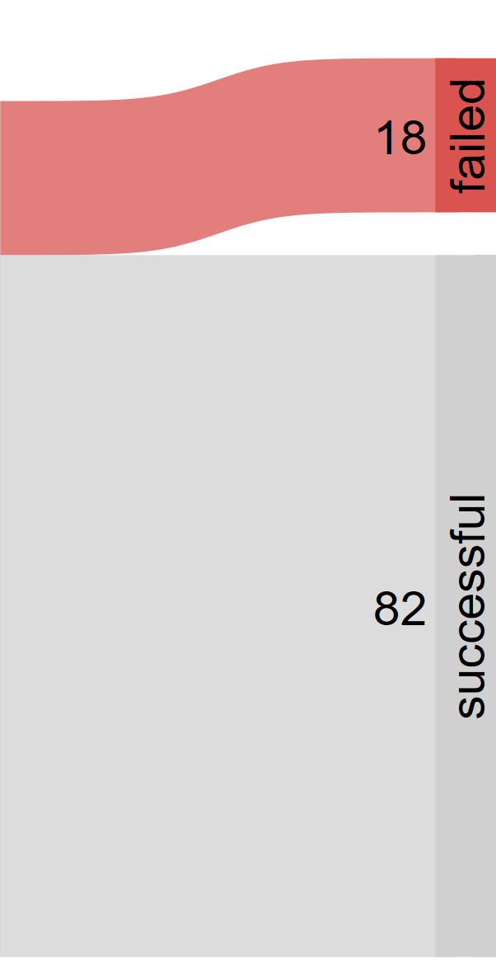
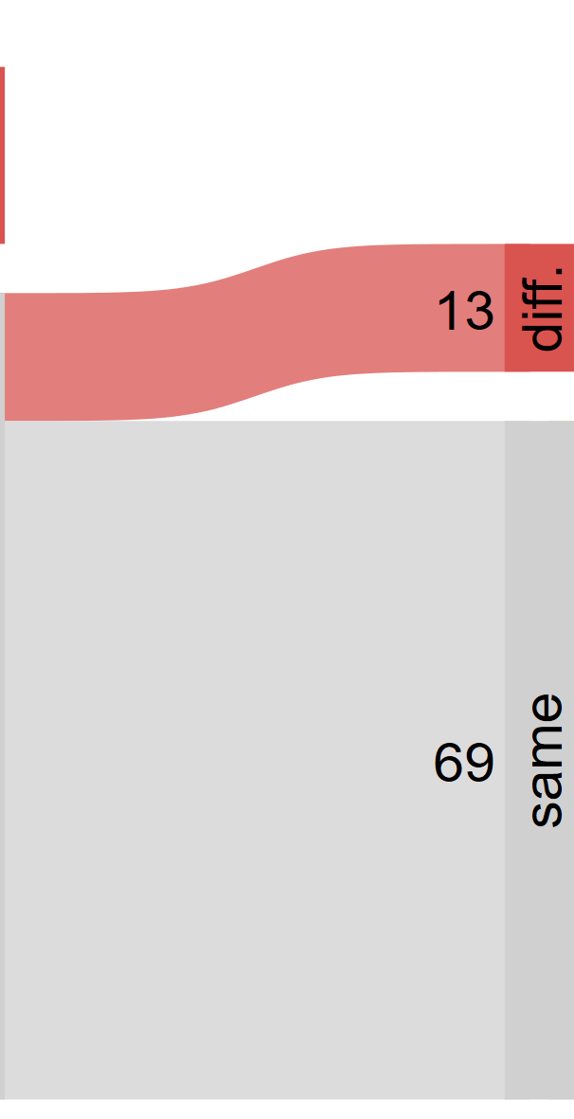
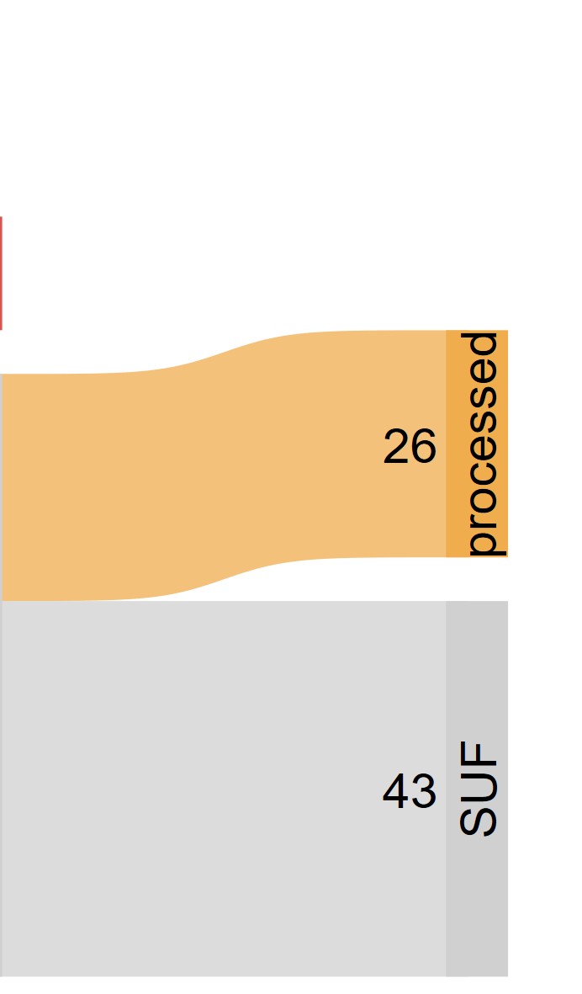


“Houston, we have a problem“
Code Execution
Results
Data
Alarming
(for science)
Baffling
(for programmers)
Own reproducibility audit; sankey (A. Naqvi)
Notes:
Background:
Meta-research project, aiming to reproduce 100 published social science studies
Specifically, studies using ESS data for which we obtained original analysis code
Further restriction: Studies that only use Stata
Results
A sizeable share of studies, almost 20%, already fails at the level of code execution despite the fact that we have data and code
Of the remaining studies, 13 yield different results
That leaves us with a reproducibiltiy rate of 69%. But don‘t get too excited: More than a third of these studies started from a pre-processed version of the ESS data that we could not trace back to the raw data. In an extreme case, these studies loaded an opaque dataset and ran a couple of regressions
Interpretation: What do we make of this?
A: It‘s alarming for science. Of what value are results that are irreproducible, even with the original data and code?
B: It‘s irritating from a programming perspective. How do you even manage, as a professional scientist, to have such an irreproducible workflow?

Slide 3
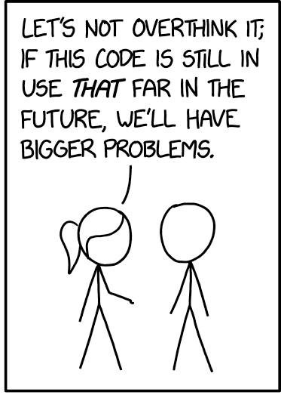
“Houston, we have a problem“
Code Execution
Results
Ados
File paths
File management (!)
Randomness
Runtime
Unknown (?)
XKCD (modified)
Notes:
Various reasons why reproducibility might fail at either of these two stages (execution & results). Insights from our project:
Execution:
People use user-written commands that are not installed in the do-file
Minor issue if the ado is stable → quick fix via ssc install…
Major issue if the ado has been given major updates → hard to obtain original ado code because there is no version control for ados
People use hard-coded file paths over and over! (attitude towards programming is summarized in this cartoon; not written with reproducibility in mind)
In General: File Management
This means: unclear dependencies, missing/unclear files
Believe it or not: People manually load data into stata and write only their analysis routine into a do-file → Unclear starting point!!
Results:
Randomness: Usually only minor numerical deviations, but still a nuisance
Runtime: Not necessarily different results, but inability to verify results because models take a long time with no documentation of their runtime
Sometimes: No idea why results are different

Slide 4



Are authors deliberately obstructing reproducibility?
NO!
“I would like to help, but…“
“I can‘t find the code“
“I don‘t understand my code“
“I don‘t have the time“
→ It‘s about skills, not willingness
skills
Notes:
If reproducibility often fails, this begs a ciritical question
Luckily, from my experience, the answer to this question is no
Authors are very willing to cooperate to be reproducible, but face various problems
Replies that we got in personal correspondence
Impression: Researchers want to be reproducible, but they lack the skills

Slide 5
The Status Quo
desired
(by researchers)
valuable
(for science)
Reproducibility
possible
(with Stata)
rare
(in practice)
→ Minimize costs to work reproducibly in Stata
Notes:
Where does this leave us?
As I‘ve just said reproducibility seems to be desired by authors.
Reproducibility is valuable for science as a whole. (if you disagree, I‘m happy to chat over coffe, as I won‘t bother to make this case for this statement here)
Reproducibility, and this makes this whole topic somewhat frustrating, is of course possible with Stata. In fact, it might even be easier in Stata than in other Software due to stricter version control.
And yet, reproducibility is rare.
My conclusions from this is: We need to find ways to make it easier, i.e. reduce the costs, to work reproducibility in Stata. This is exactely what my ado, that I‘m about to show you, aims to do.

Slide 6
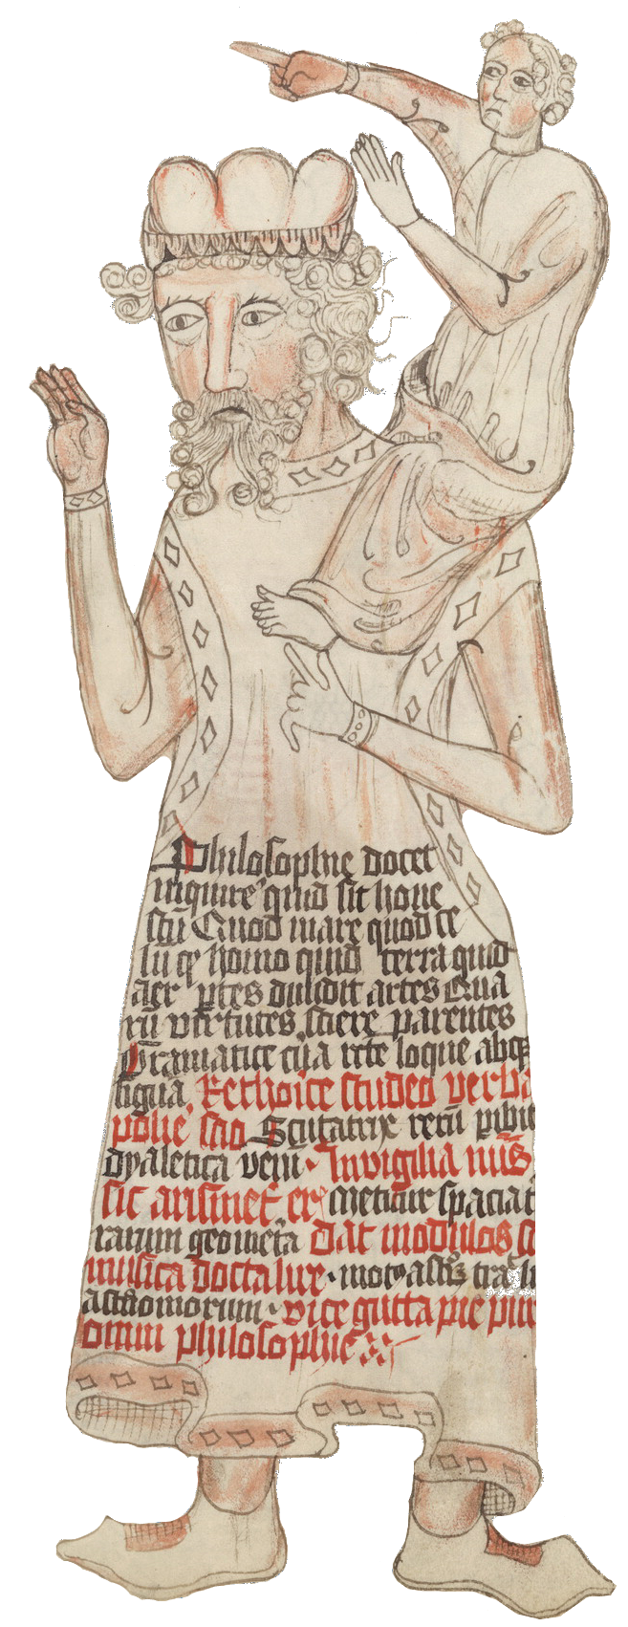
Precursors to repreport
Log-files and user-written commands:
callsado | D. Klein | setroot | S. Correia, M. Seay
dependencies | D. Goldemberg | stata_linter | DIME Analytics
iedorep | B. Daniels | stata_reproducible | B. Quistorff
ietoolkit | DIME Analytics | statapackagesearch | L. Reiner
installpkg | K. Du | texdoc | B. Jann
project | R. Picard | usepackage | E. Booth
repkit | DIME Analytics | zippkg | D. Bela
require | S. Correia, M. Seay | …
Notes:
Before we get to the details, let me acknowledge that my ado is standing on the shoulders of giants, some of whom are in this room today.
Much thought has gone into making analyses in Stata transparent, whether it is through using log-files or user-written commands geared towards reproducibility.
I won‘t get into the details of what each of these commands is doing but suffice it to say that although none of it does exactly what I had in mind when I started this project, I‘m borrowing ideas and inspiration from various of these.

Slide 7
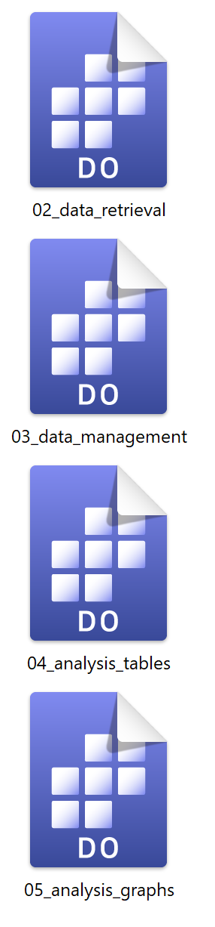
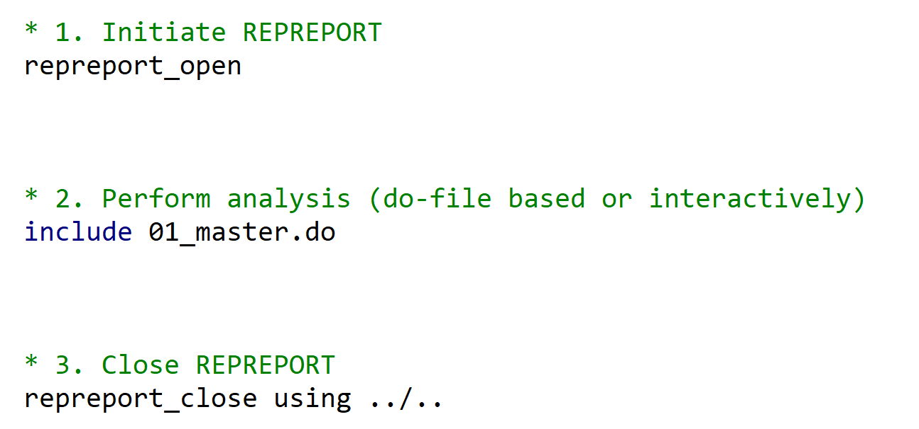
Using repreport: Frontend
Notes:
Let‘s start with the hands-on part: What do users have to do when using repreport?
The procedure is fairly simple: Like with a log-file, they…
…first open a repreport…
…then run their analysis (in whatever way it is structure; do-files or interactively, or a mix)…
… and finally close the repreport.
The analogy to a conventional log-file is no coincidence, as you can see when we explore what repreport does „under the hood“.

Slide 8
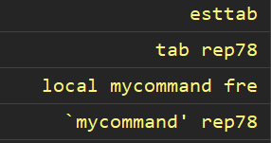
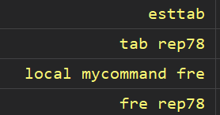
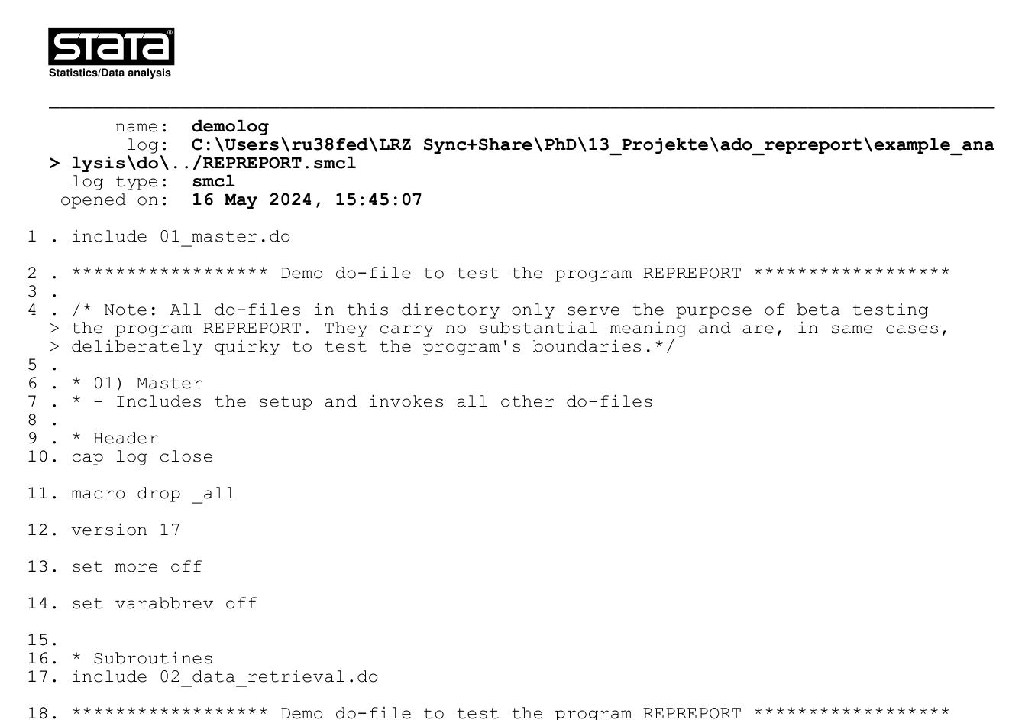
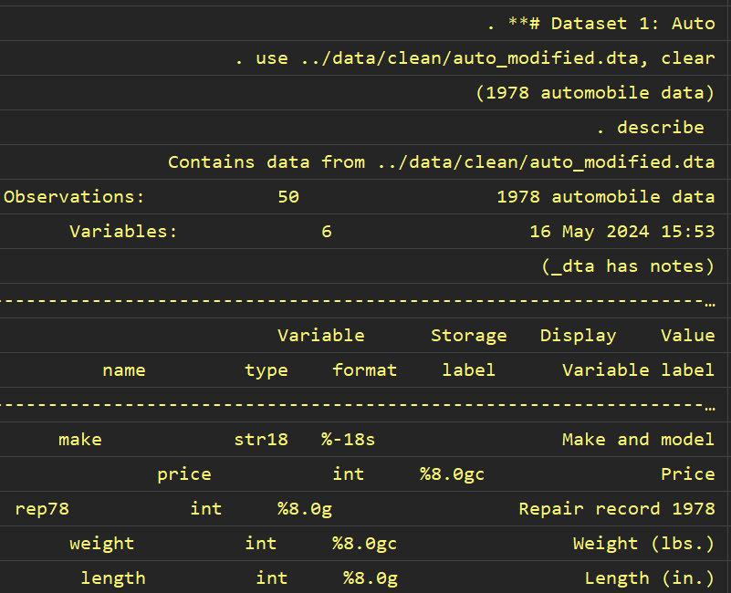


Understanding repreport: Backend
log entire analysis
substitute
macros
reconstruct “clean“ command history
Elicit reproducibility features
(ados, datasets, randomness, etc.)
import as data
(smcl)
generate output
Notes:
In fact, the first step is exactely this: Repreport creates a log-file for the entire analysis from start to end.
However, it does not stop there.
Once the analysis is complete, the logfile is imported back to Stata as data.
The resulting dataset it pretty messy because it contains everything from the log file, including output, comments, Stata return statements, etc.
To make anything meaningful out of this, this dataset needs to be cleaned. This is actually where most of the action/hard work is taking place. What the ado does is gradually clean and refine the log-dataset to reconstruct the original commands history.
To give you an idea what this means: The ado, for instance, identifies comments, output, multiline commands, etc. and handles them appropriatly (for comments: delete them, as they are irrelevant for reproducibility; for multiline commands: concatenate them into a single line)
The next step is a quirk that might seem unneccessary: The ado identified macro definition and actually executes them to elicit what Stata truly „sees“ in a certain line of code.
For example, consider this code here: If we want to know what user written commands were used in this section, we would overlook „fre“ because it is „hidden“ in a macro. This is no longer the case once we perform macro substitution.
Once we‘ve made it to here, the fun part begins: Now we have a clean and comprehensive record of the entire analysis that we can scan for reproducibiltiy features.
For instance, consider how you would identify user-written commands in this dataset. You would scan the first word of each observation and compare it to your recollection of Stata commands. If it is a built-in command, you would skip it. If it is not, you would flag it. This is exactely what the ado does.
For datasets, the story is slightly different: Here, the ado searches for keywords (e.g. use, import, etc.) and extracts the name and location of the dataset that is being used.
The results of these searches yield two outputs:

Slide 9
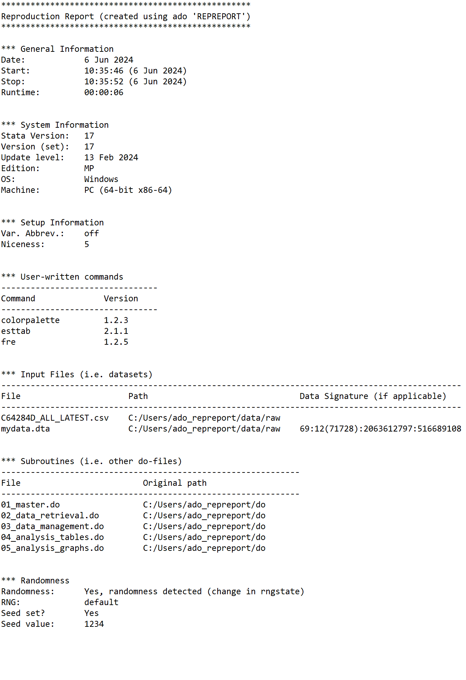


Output I: Reproducibility Report
“Technical ReadMe“:
  General Information
  System Details
  Setup
  User-written commands
  (+ versions)
Notes:
The first one is what gives the ado its name: a report
Think of this report as a technical readme-file.
It contains information when the analysis was conducted, on what machine, how long it took, what general setting were used, etc.

Slide 10
Output I: Reproducibility Report
“Technical ReadMe“:
  General Information
  System Details
  Setup
  User-written commands
  (+ versions)
  Input files
  (+ location and signatures, if applicable)
  Subroutines
  (+ location)
  Randomness
Notes:
The first one is what gives the ado its name: a report
Think of this report as a technical readme-file.
It contains information when the analysis was conducted, on what machine, how long it took, what general setting were used, etc.

Slide 11
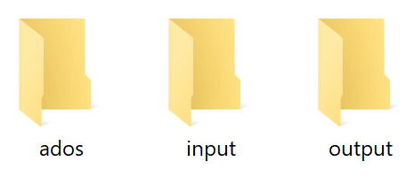
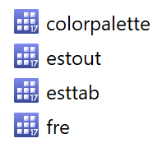
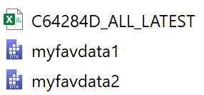
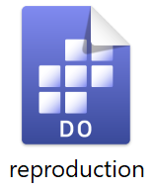


Output II: Reproduction Materials
File collection:
  3 Directories:
    Ados
    (all ados in user‘s current version)
    Input
    (all input files, e.g. datasets, csv, etc.)
    Output
    (storage for output)
  1 Do-file
→ Standardization increases chances for „push-button“ reproducibility

Slide 12

Beta-Testing (GitHub)
https://tinyurl.com/repreport-beta
Please reach out to report bugs or suggest improvements!

Slide 13
Conclusion
repreport facilitates reproducibility at no extra cost.
Who wins?
computational expertise
…
social scientists
(in our sample)
most of
you
some of you
value of repreport

Slide 14
Discussion
Technical
Ado dependencies
Reliable detection of file paths (?)
Substantive
Caution with original data
“Brute force“ do-file is comprehensive
(although it is not elegant)
Zero costs for users
(unlike more elaborate solutions)
–
–
–
+
–
+
+
–
+
–
–
+

Slide 15


THANKS!
Daniel.Kraehmer@soziologie.uni-muenchen.de
www.danielkraehmer.com
https://tinyurl.com/repreport-beta

